Slide 1
Values
Does the precedent put any constraint at all on how to decide a new case?
Let’s assume that every case has some factor that differentiates it from every other case (remember, factors can be complex).
It would seem we could justify either verdict by citing that idiosyncratic factor as the reason.
Since the factor does not occur in the precedent, such a decision would be consistent with the precedent.
Thus it is always consistent with the precedent to make either judgment; the precedent leaves open how to decide a new case.

Slide 2
Values
David Lewis provides a nice illustration of this.
Suppose A calls B; the call is cut off, and A calls back, thus establishing a precedent for any future case in which the call drops out.
The next day, B calls A. Once again, the call drops out. What should they do, given the precedent?
The precedent seems to underdetermine the answer. On the first occasion, A called back, so perhaps that is what should happen again.

Slide 3
Values
But another way to describe the first occasion is to say that the original caller called back. This time, the caller is B. So perhaps it should be B who calls back.
In the legal examples, the judge cites a reason for the judgment. No problem. We can add that feature to Lewis‘s case. Suppose, on the first occasion, A tells B that he called back because he was the original caller. So we have a precedent in which the original caller called back. At first this seems to solve the problem. Doesn’t the precedent tell them that B should call back the second time?
It would tell us that if the second case were the same as the first in all particulars, but it is not (it cannot be!).

Slide 4
Values
For instance, in the second case, A was the receiver. This could be important. Perhaps important enough to outweigh the consideration (in favour of B calling back) that B was the caller.
Or it could be that the day of the call is Tuesday, whereas the case in the precedent was a Monday. That could change everything.
So a precedent, even one in which the reason for the decision or action is explicitly cited, does not determine, on its own, what to do in any other case.

Slide 5
Values
Nevertheless, we tend to know what to do to coordinate in such situations, and immediately discount the considerations adduced a moment ago – what does it matter that it’s a Tuesday!
Something allows us to choose among the options left open by the precedent, so that, in combination with that something, precedent really does tell us what to do.
Our name for that additional source of constraint is “value.”

Slide 6
Values
You’ll recall that “value” is modelled as a set of defaults $𝒱$ of the form (where $r, r^{′}$ are defaults):
$$⊤→r≺r^{′}$$
Value is intended to be a wide umbrella.
If we want it to solve Lewisian coordination problems, then it should include resources that underwrite the shared psychological focus that Lewis and Schelling have argued is responsible for this.
Notes:
How big is V? It seems to be infinite.

Slide 7
Values
On the other hand, if we believe (as we should) that agents’ hunches of how to extend a precedent are sometimes wrong, then we must go beyond individual agents’ psychologies in tabulating $𝒱$.
The correct way to extend a precedent to a case presumably depends on objective norms for ranking reasons, existing independently of what agents think and do.
Since agents’ mental lives at least approximate what is rational, their grasp of the objective norms, which must therefore tend to overlap, could help to predict a portion of the coordination facts.

Slide 8
Values
Let’s assume, then, until we have to give the idea up, that there is an “objective” $𝒱$ that we can combine with the precedent and use to determine the objective status of at least the clear cases.
To the extent that we have to give this up, apparently objective matters, such as category membership, become infected with subjectivity. This could be the right view, but it will take some convincing for me to come round to it!

Slide 9
Faultless disagreement
Even if the values relevant for extending a precedent are objective, our knowledge of them may be less than perfect, leading to mistakes. This is a design feature.
But it also leads to an interesting outcome. Two people might have conflicting opinions about how to extend the precedent without either being wrong (both ways are rationally permitted according to the objective tabulation of the decision situation).
In other words, we predict (for a predicate that is vague, and for agents whose opinions don’t perfectly track objective value) what one might call faultless disagreement.

Slide 10
Faultless disagreement
Faultless disagreement with this origin is not consistent with perfect precision (it is not available to epistemicists, since there is always a fact of the matter, and hence someone at fault), nor with perfect knowledge, but otherwise comes for free on the account developed so far.
Interestingly, it has been recognized as an empirical phenomenon in the linguistics literature, and it is most expected to appear where the relationship between the category and the case vocabulary is vague.

Slide 11
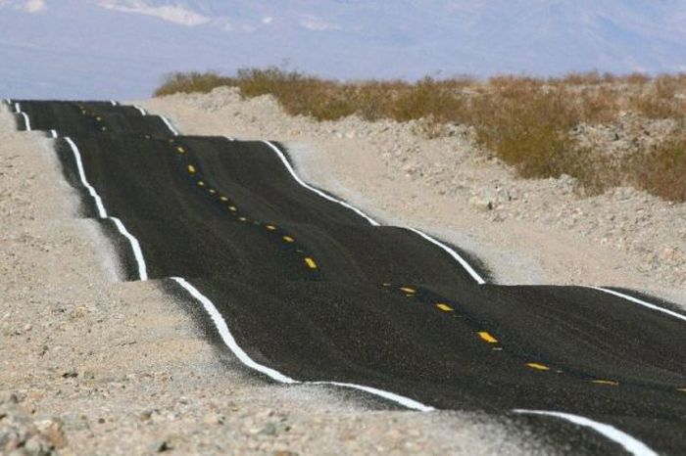
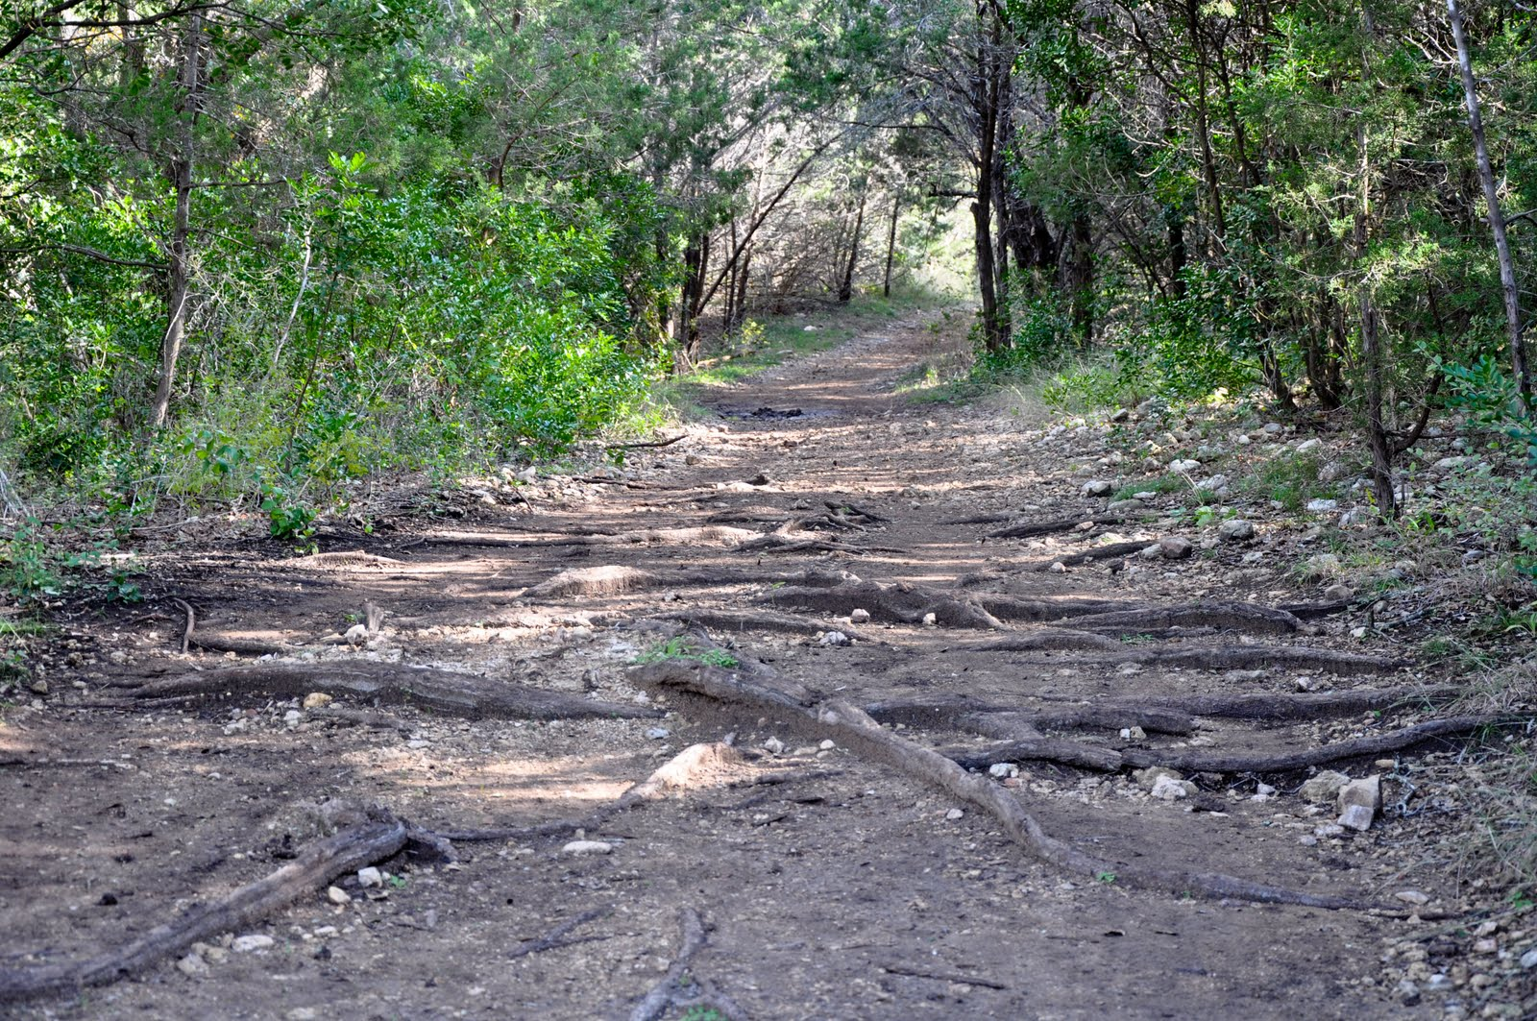
Notes:
Which road is bumpier? Why?

Slide 12
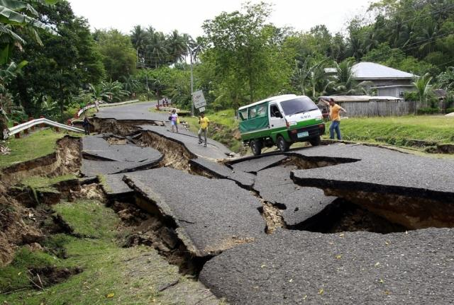

Slide 13
Evaluative predicates
This sort of faultless disagreement has been discussed much less than that involving predicates that are explicitly evaluative, such as ‘beautiful’ or ‘tasty’.

Slide 14
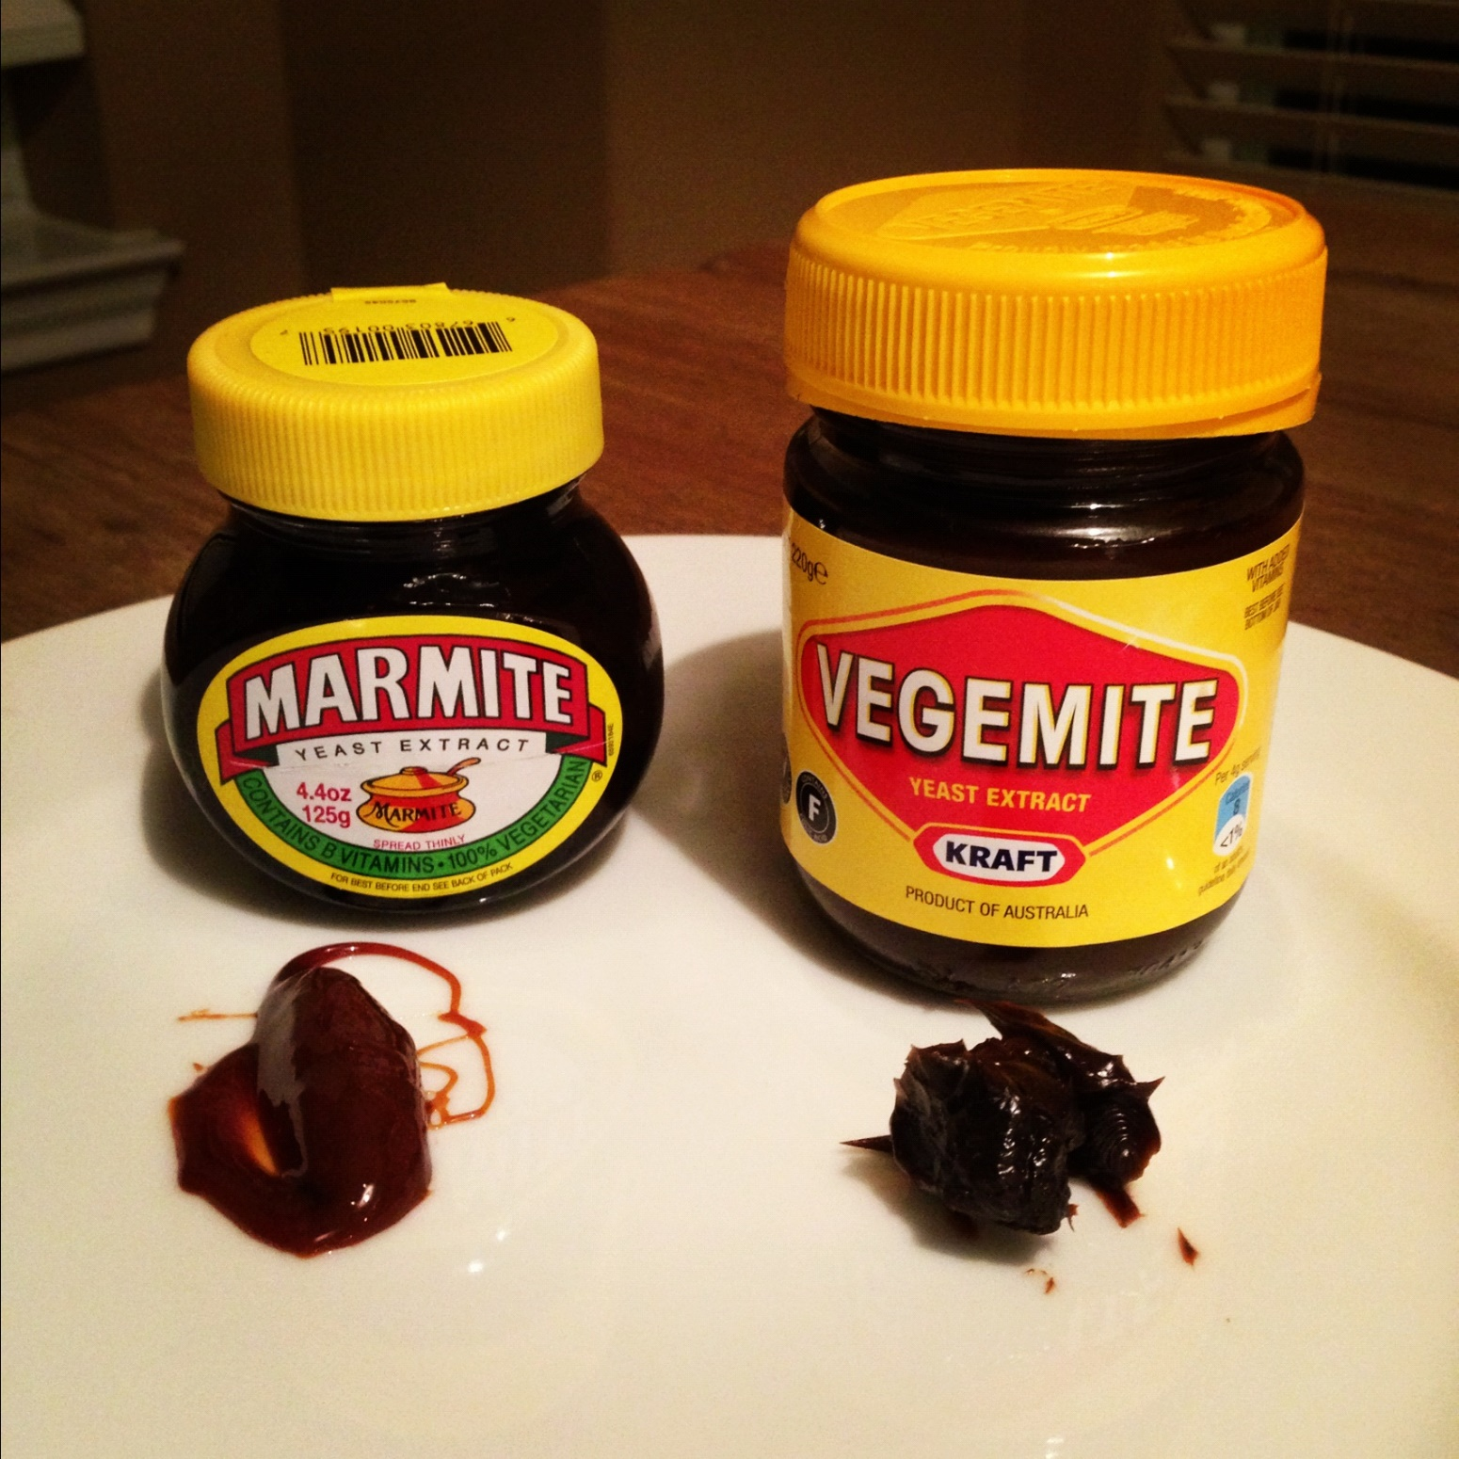
Notes:
Which is tastier?

Slide 17
Evaluative predicates
There is a key difference between evaluative predicates and those that are merely vague.
We can stipulate which road counts as bumpier that which, but we can’t stipulate what counts as tastier, or better, or more beautiful.
This is unexpected on accounts (e.g. Barker 2013) that explain the phenomenon the same way in both cases.
Barker thinks that, like disagreements about how to rate relative bumpiness, or what height counts as tall, “disagreements about taste are disagreements about the discourse.”

Slide 18
Evaluative predicates
But it seems to me (following Hare 1952, a.o.) that true disputes over taste directly concern the evaluation of the subject matter, rather than the meaning of the evaluative term being applied to that subject matter.
They do not, therefore, concern the relative importance of factors relevant to the interpretation of a precedent.
This explains why stipulation has no effect.
One cannot stipulate that ‘tasty’ is to mean juicy or sweet while conforming to the linguistic precedent.
Notes:
These include Lasersohn (2008, p.4), as reported in Umbach (unpublished); and Solt (forthcoming).

Slide 19
Evaluative predicates
While it is possible to negotiate the meaning of evaluative predicates, this can only be done within certain bounds.
For instance, if we were restaurant reviewers used to rating dishes on the same 1-7 scale according to the pleasantness of the flavor, we might disagree about what ranking, 5 or 6, qualified as tasty, and our editor might even arbitrate for us.
But if I liked knockout flavours while you preferred more subtlety in the seasoning, that is not a conflict the editor could resolve by a stipulation about the meaning of ‘tasty’.

Slide 20
Evaluative predicates
Whether ‘tasty’ applies
the pleasantness of the flavor
the level of seasoning, etc.

Slide 21
Evaluative predicates
Whether ‘bumpy’ applies
the frequency and amplitude of the bumps, etc.

Slide 22
Evaluative predicates
Whether ‘bumpy’ applies
the frequency and amplitude of the bumps, etc.
the landscape being traversed, the amount of grading,
recent earthquakes or mudslides, etc.

Slide 23
Evaluative predicates
Whether ‘good’ applies
the valence of the evaluation
juiciness, sweetness
(in the case of strawberries)

Slide 24
Evaluative predicates
Whether ‘tasty’ applies
the pleasantness of the flavor
the level of seasoning, etc.

Slide 25
Evaluative predicates
Whether ‘tasty’ applies
the pleasantness of the flavor
the level of seasoning, etc.
point of disagreement
point of disagreement

Slide 26
Evaluative predicates
Whether ‘bumpy’ applies
the frequency and amplitude of the bumps, etc.
the landscape being traversed, the amount of grading, etc.
point of disagreement

Slide 27
Evaluative predicates
Whether ‘tasty’ applies
the pleasantness of the flavor
the level of seasoning, etc.
point of disagreement
point of disagreement

Slide 28
Evaluative predicates
Whether ‘tasty’ applies
the pleasantness of the flavor
the level of seasoning, etc.
point of disagreement
(semantic)
point of disagreement
(evaluative)

Slide 29
Evaluative predicates
Faultless semantic disagreement requires vagueness.

Slide 30
Evaluative predicates
Whether ‘good’ applies
the valency of the evaluation
juiciness, sweetness
(in the case of strawberries)
point of disagreement
(evaluative)
Notes:
If ‘good’ is not vague (unlikely), then the only possible disagreement goes here.

Slide 31
Evaluative predicates
Faultless semantic disagreement requires vagueness.
What does faultless evaluative disagreement require?
The absence of a fact of the matter (i.e. certain factors in the value judgment lack an objective ranking)
Conflicting opinions about how those factors are ranked

Slide 32
Evaluative predicates (update)
If I inform you (laconically) that
Burning Man was fun.
Then this may give you some idea of what Burning Man was like.
If I say the same thing as we pull into our hotel in Reno, right after attending the Burning Man festival for a week together, then it is more of a proposal to evaluate the properties we both attribute to the event in a certain way.

Slide 33
Evaluative predicates (update)
The difference is similar to the one Barker (2002) notices between two uses of
Feynman is tall.
One use tells us about Feynman’s height, another acts as a proposal to treat a known height as tall.
The difference is that in Barker’s case, the issue is semantic (what should we categorize as tall?), whereas in the Burning Man case the issue is what should we value?

Slide 34
Evaluative predicates (update)
This makes flat attributions of ‘fun’ or ‘tasty’ galvanizing.
They can reinforce intimacy by assuming a shared perspective on value.
But they also endorse/valorize that perspective to the exclusion of others.
Sometimes (too often!) a proposal to update the common ground is really an invitation to a fight.
Notes:
See: the internet!

Slide 35
Evaluative predicates (update)
Evaluative attributions can also be used to inform about value, but this is in the comparatively rare case where the audience doesn’t already hold an opinion.
For instance, I might be introducing you to an obscure form of textile art, where objective comparisons corresponding to that of Michaelangelo vs. Koons would not be out of place, being indeed informative.

Slide 36
How it works
When a legal case is judged, case defaults of the form:
$$c→r≺r′$$
are added to the judgment situation that represents the content of the common law.
Also, judgments overrule any existing, contrary value-based preferences. This part is enforced by precedent defaults of the form:
$$⊤→r≺r′$$

Slide 37
How it works
Something analogous occurs when we make a semantic stipulation, such as Road A is bumpier than Road B, or Feynman is tall.
Some of the time, semantic stipulations include the citation of a reason, as when it was decreed that
Pluto is not a planet because it hasn’t cleared its orbit.
In the latter sort of case, the update is identical in form to that in the legal case.

Slide 38
How it works
If no reason is cited, we update as though the strongest reason for the verdict were the one cited.
We are assuming that a set of factors for the same side is stronger than any of its strict subsets, so the strongest reason for the verdict will be the complete set of factors favouring it.
In other words, we will update in those cases by adding the default
$$c→r≺r′$$
where
${r=(F}^{s}→s)$ and ${r′=(F}^{\overline{s}}→\overline{s})$

Slide 39
How it works
The other use of ‘Feynman is tall’ is as an assertion.
That is, a commitment to something factual (usually as a means of giving others a reason to believe it).
It seems to me that the uses involved in faultless disagreements are assertions, rather than stipulations.
It is quite another thing to disagree on how to refine the meaning of a word, which is a kind of practical disagreement.

Slide 40
How it works
Note that assertion does not preclude metalinguistic update, it is just that the update is epistemic, rather than semantic (it enlarges our shared knowledge of the language, rather than refining the conventions of language itself).
So when I utter, ‘Pluto’s not a planet’, this can only update my audience’s knowledge of the convention.
But when the IAU uttered it in 2006, it contributed (in the way we have already discussed) to the convention itself.

Slide 41
How it works
Suppose we model the context using a default theory.
An assertion that p gives us a reason to add p to our knowledge base, so we treat the update as adding a default of the form:
$$u→p$$
When p is a direct claim about a “value” (of the form: $r$ is a stronger reason than $r^{′}$), then the default will look like this:
$$u→r^{′}≺r$$

Slide 42
How it works
An evaluative update could be used to reinforce a shared value, inform another of an area of value they are ignorant of, or even antagonize an audience with the opposite opinion.
A faultless disagreement on value is a case where two people take opposite stances and there is no fact of the matter.

Slide 43
How it works
So if the disagreement were explicit, the context would contain:
$u_{1}→r^{′}≺r$ and $u_{2}→r≺r^{′}$
While the objective judgment situation would contain neither:
$⊤→r^{′}≺r$ nor $⊤→r≺r′$

Slide 44
How it works
The update contributed by an utterance could conflict with an objective value.
Schematically, we could have$u→r^{′}≺r$ along with $⊤→r≺r′$.
But unlike the case of precedents in the common law, the mere fact that someone made an assertion that conflicts with a value doesn’t override that value.
Merely saying that vegemite is better than marmite doesn’t make it so!
Hence there is no equivalent to the precedent defaults that automatically resolves conflicts between utterances and values.
Notes:
An utterance could also conflict with a value default already in the context (i.e. established/assumed to be shared), or with a value default in the audience’s subjective state. Again, there is no automatic override.

Slide 45
How it works
Even a judgment in the common law doesn’t change the value.
It is just that, in the common law, judging cases in conformity with the precedent is more important than judging them according to objective values.
Something similar could be said for following a linguistic convention; the linguistic precedent is of the first importance in making objective determinations (about application and truth).
Only where it does not determine the answer are we to consult (objective) values.
Notes:
An utterance could also conflict with a value default already in the context (i.e. established/assumed to be shared), or with a value default in the audience’s subjective state. Again, there is no automatic override.

Slide 46
How it works
Obviously, mere assertion about values (or anything else) does not occupy a similar position with respect to evaluative judgment.
To determine if ‘Marmite is better than Vegemite’ is true, we need only consult the facts about value (the elements of $𝒱$ in the objective judgment situation).
If an assertion is at odds with the facts, it does not override them: it is simply false.
If there is no fact of the matter (as in a case of faultless disagreement), the assertion still does not carry the day (though we treat it as expressing an opinion that is rationally permissible).
Notes:
An utterance could also conflict with a value default already in the context (i.e. established/assumed to be shared), or with a value default in the audience’s subjective state. Again, there is no automatic override.

Slide 47
Conclusion
Faultless disagreements crop up in the unsettled regions of vague predicates, as well as in unsettled regions of value.
Structurally, the situations are parallel, and both arise from the absence of a relevant fact of the matter, along with imperfect knowledge of the facts.
However, in the first – semantic – case, an arbitrary stipulation would supply the grounds for deciding a subsequent judgment.
Whereas (aesthetic, moral, etc.) evaluation is supposed to judge the values directly.

