Slide 1
Analysis by Default
NASSLLI 2016
Rutgers, New Jersey

Slide 2
Analysis by default
Rather than try to construct a detailed definition of a planet which is designed to cover all future possibilities, the WGESP has agreed to restrict itself to developing a working definition applicable to the cases where there already are claimed detections … As new claims are made in the future, the WGESP will weigh their individual merits and circumstances, and will try to fit the new objects into the WGESP definition of a “planet,” revising this definition as necessary. This is a gradualist approach with an evolving definition, guided by the observations that will decide all in the end. (IAU Working Group on Extrasolar Planets, 2003; quoted in Ludlow 2011, p.77)

Slide 3
Analysis by default
Recall a “working definition” was one that successfully distinguished known cases, but also left room for judging future doubtful cases “on their merits,” and incorporating that judgment into the “evolving” definition.
We can now think of “known” cases as the cases already settled (judged) in the precedent determining the relevant linguistic convention, of which competent speakers have some (sufficient) degree of knowledge.

Slide 4
Analysis by default
The set of “case defaults” that rank the factors occurring in the settled cases in accord with their judgments will predict the same judgments on those cases, and so performs the first duty of a working definition (i.e. distinguishing known cases).
These are supplemented by a set of “value defaults,” not produced by the judgments in the precedent, but prior to them.
Together, the rankings derived from cases and values are used to issue judgments on new cases.
Adding the value defaults won’t change the judgments on the old cases, thanks to the rule that precedent takes priority over value (enforced by the precedent defaults).

Slide 5
Analysis by default
As new cases are “weighed on their merits” by a combination of the case and value defaults, judgments are issued which further extend the precedent.
Alternatively, if the case and value defaults leave the verdict open, a judgment that is issued will have an element of arbitrariness (but will nevertheless extend the precedent in the same way).

Slide 6
Analysis by default
For instance, suppose we are looking at the first ice-cream sandwich ever made and deciding whether it belongs to the category sandwich.
In favour of inclusion is the fact that it consists of a slab of ice-cream (a filling) between two cookies.
Against, is the fact that the outside layers are not bread.
Any other relevant factors?

Slide 7
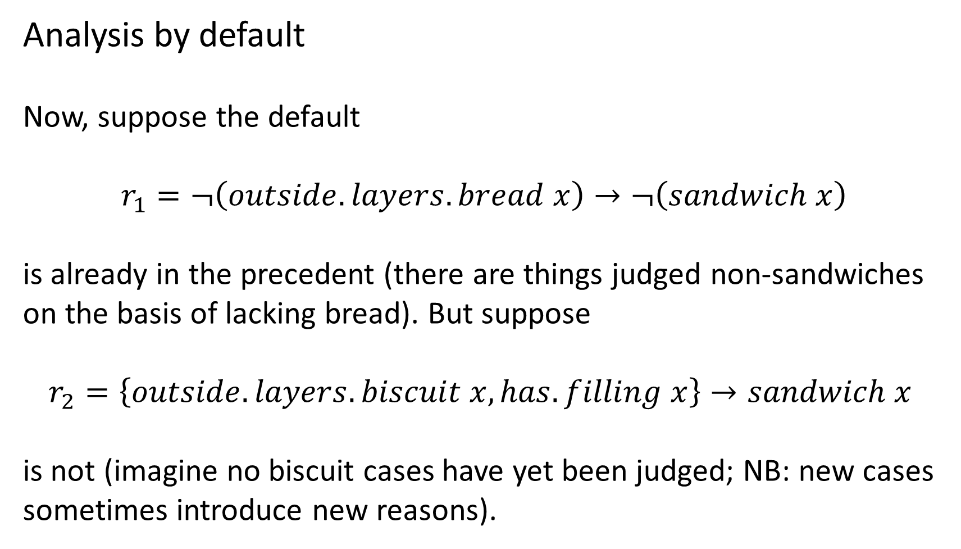
Analysis by default
Now, suppose the default
$$r_{1}=¬\left(outside.layers.bread x\right)→¬\left(sandwich x\right)$$
is already in the precedent (there are things judged non-sandwiches on the basis of lacking bread). But suppose
$$r_{2}=\left\{outside.layers.biscuit x, has.filling x\right\}→sandwich x$$
is not (imagine no biscuit cases have yet been judged; NB: new cases sometimes introduce new reasons).

Slide 8
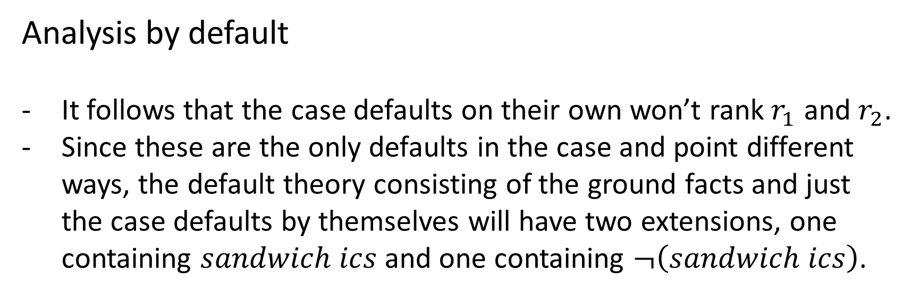
Analysis by default
It follows that the case defaults on their own won’t rank$r_{1}$ and $r_{2}$.
Since these are the only defaults in the case and point different ways, the default theory consisting of the ground facts and just the case defaults by themselves will have two extensions, one containing $sandwich ics$ and one containing $¬\left(sandwich ics\right)$.

Slide 9
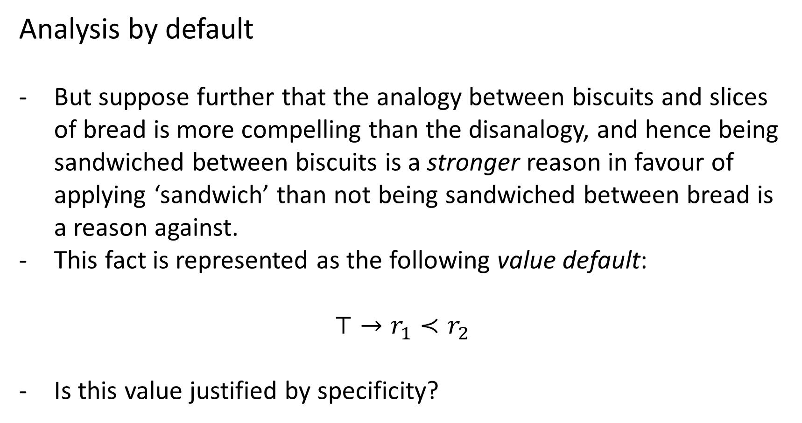
Analysis by default
But suppose further that the analogy between biscuits and slices of bread is more compelling than the disanalogy, and hence being sandwiched between biscuits is a stronger reason in favour of applying ‘sandwich’ than not being sandwiched between bread is a reason against.
This fact is represented as the following value default:
$$⊤→r_{1}≺r_{2}$$
Is this value justified by specificity?

Slide 10
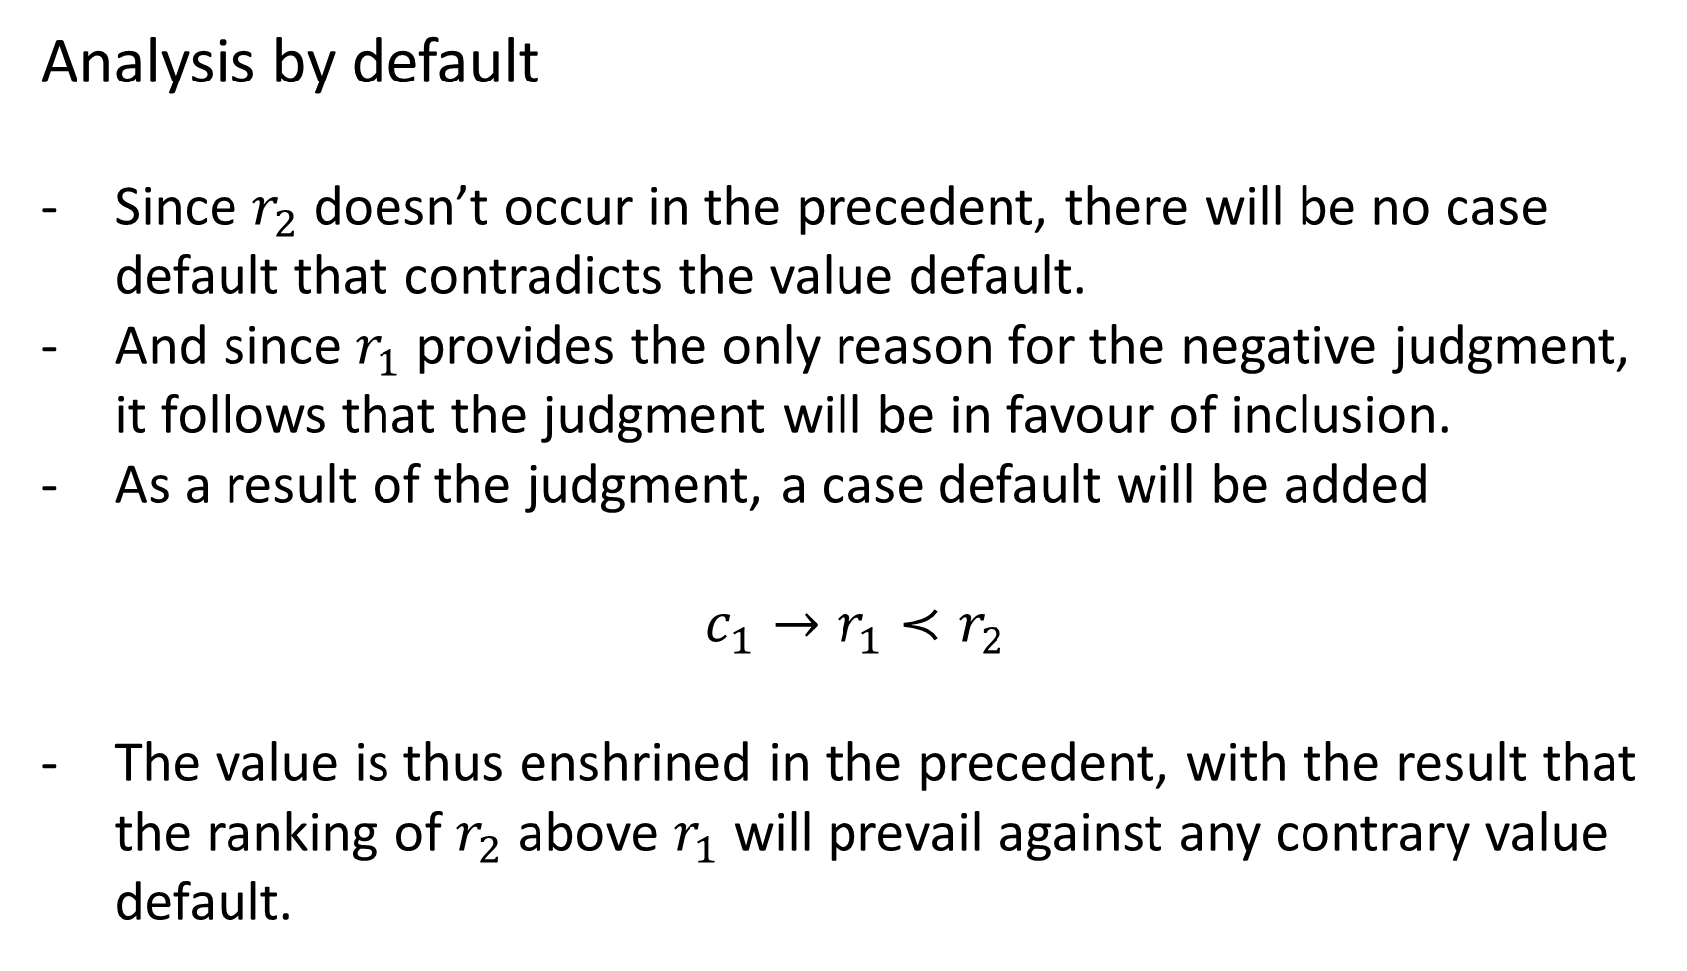
Analysis by default
Since $r_{2}$ doesn’t occur in the precedent, there will be no case default that contradicts the value default.
And since $r_{1}$ provides the only reason for the negative judgment, it follows that the judgment will be in favour of inclusion.
As a result of the judgment, a case default will be added
$$c_{1}→r_{1}≺r_{2}$$
The value is thus enshrined in the precedent, with the result that the ranking of $r_{2}$ above $r_{1}$ will prevail against any contrary value default.

Slide 11
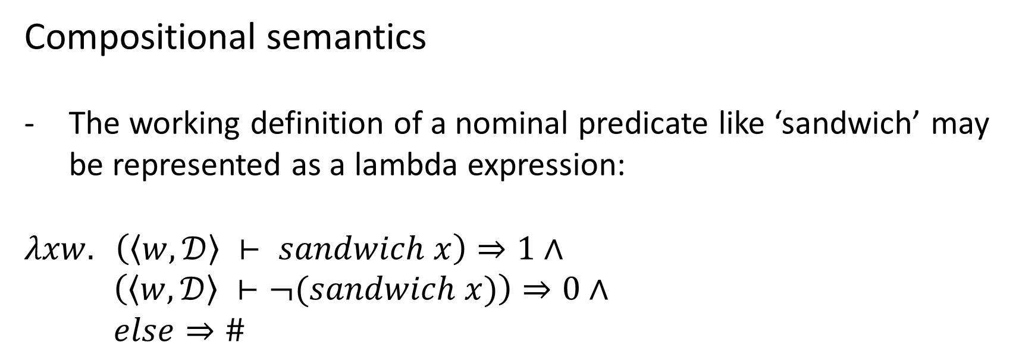
Compositional semantics
The working definition of a nominal predicate like ‘sandwich’ may be represented as a lambda expression:
$$λxw. \left(〈w,𝒟〉 ⊢ sandwich x\right)⇒1∧$$
$\left(〈w,𝒟〉 ⊢¬(sandwich x)\right)⇒0∧$
$else⇒\#$
Notes:
“Worlds” here are complete specifications of the universe in the basis language (excluding the predicate sandwich) in which candidate cases are described. This is going to cause problems, but lets ignore those for the moment.

Slide 12
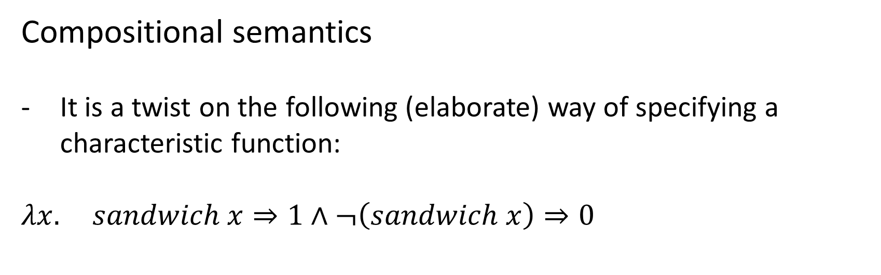
Compositional semantics
It is a twist on the following (elaborate) way of specifying a characteristic function:
$$λx. sandwich x⇒1∧¬\left(sandwich x\right)⇒0$$

Slide 13
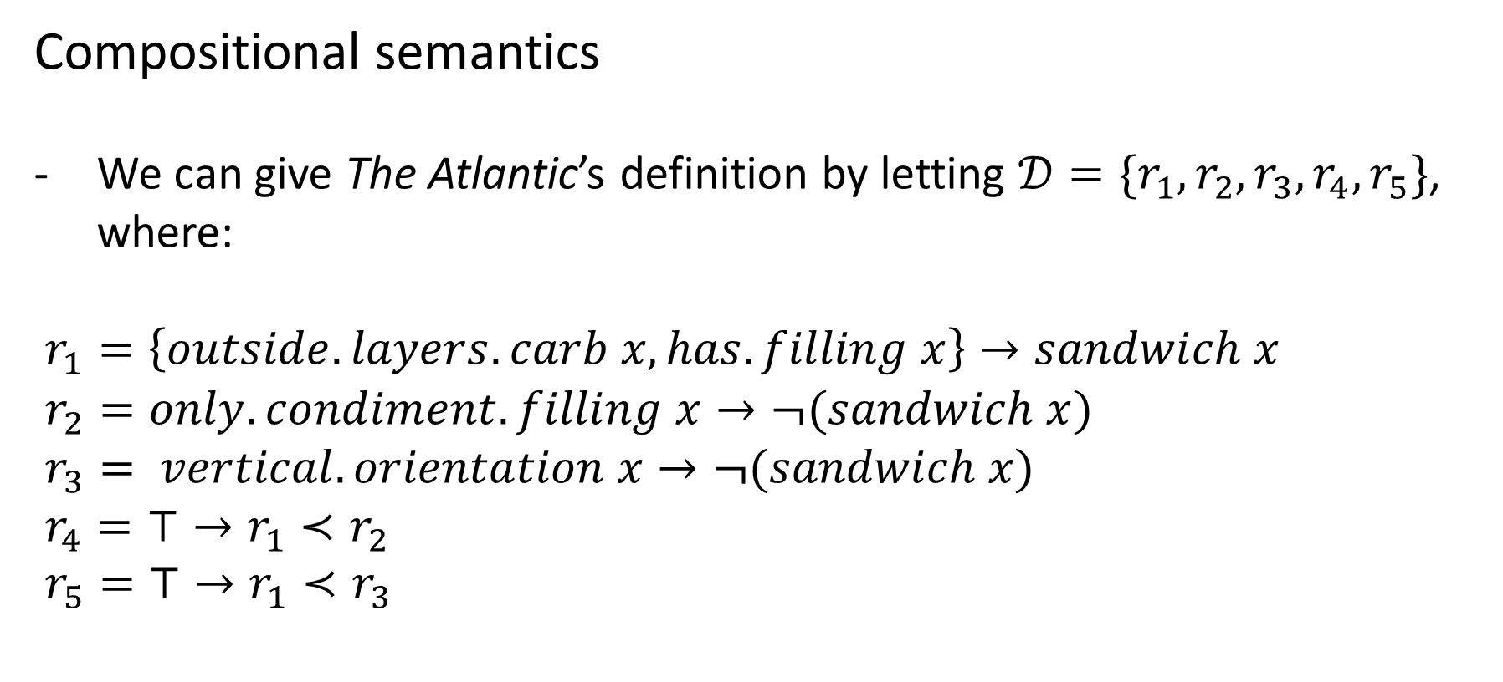
Compositional semantics
We can give The Atlantic’s definition by letting $𝒟=\{r_{1},r_{2},r_{3},r_{4},r_{5}\}$, where:
$r_{1}=\left\{outside.layers.carb x, has.filling x\right\}→sandwich x$
$r_{2}=only.condiment.filling x→¬(sandwich x)$
$r_{3}= vertical.orientation x→¬(sandwich x)$
$r_{4}=⊤→r_{1}≺r_{2}$
$r_{5}=⊤→r_{1}≺r_{3}$
Notes:
Homework: come up with some satisfying definitions in this form for concepts of interest.

Slide 14
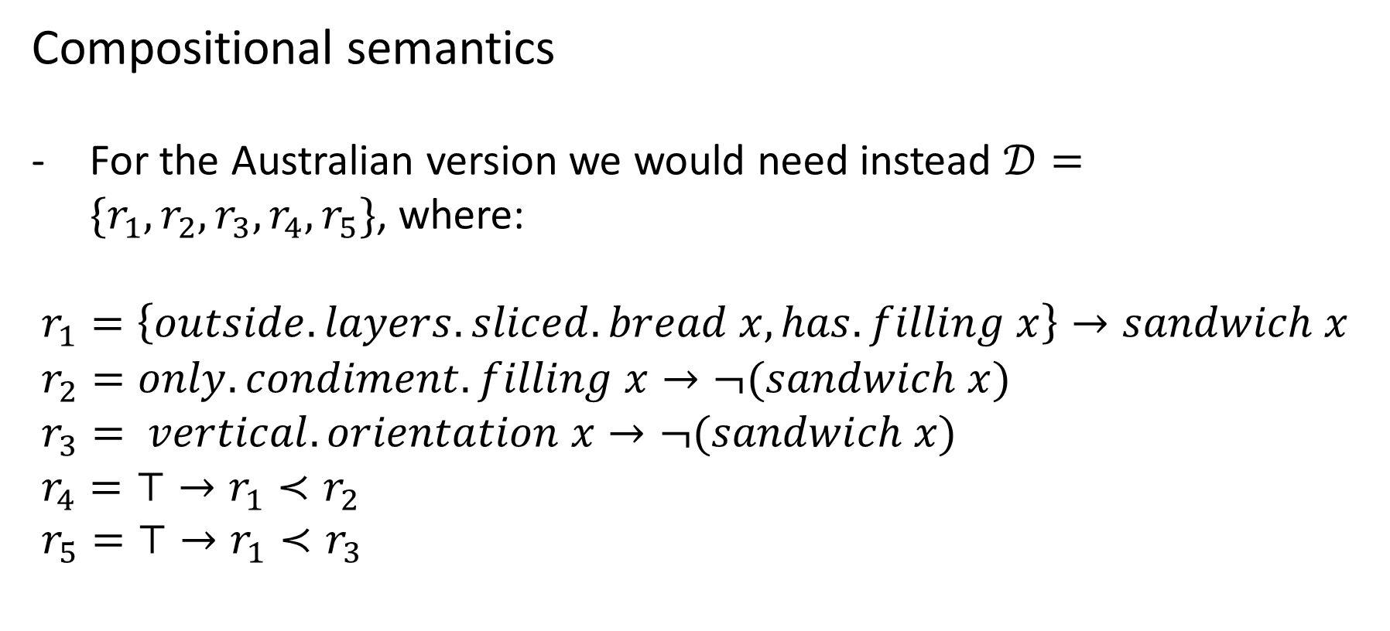
Compositional semantics
For the Australian version we would need instead $𝒟=\{r_{1},r_{2},r_{3},r_{4},r_{5}\}$, where:
$r_{1}=\left\{outside.layers.sliced.bread x, has.filling x\right\}→sandwich x$
$r_{2}=only.condiment.filling x→¬(sandwich x)$
$r_{3}= vertical.orientation x→¬(sandwich x)$
$r_{4}=⊤→r_{1}≺r_{2}$
$r_{5}=⊤→r_{1}≺r_{3}$

Slide 15
Compositional semantics
Can we see how to extend this to the other cases that helped motivate analysis (meaning change, semantic conflict, multidimensionality)?
Do you agree that it avoids the problems we associated with classical definitions (necessary and sufficient criteria)?
Now, does a working definition like the one we just gave correspond to the meaning of ‘sandwich’?
Its analysis?
A speaker’s mental representation of the meaning?

Slide 16
Vagueness
“The logic of vagueness, characterized as boundarilessness, ... remains to be described.” (Sainsbury 1990)
“Open texture … is something like the possibility of vagueness. Vagueness can be remedied by giving more accurate rules, open texture cannot.” (Waismann 1948)

Slide 17
The hard problem of vagueness
Clear cases:
Someone who is 7’ is tall.
Someone who is 4’ is not tall.
Unclear boundaries:
What is the minimum height to count as ‘tall’?
Notes:
The problem is to give a framework in which semantic theories predict all the clear cases without settling any particular boundaries on the predicate.

Slide 18

7’

Slide 19
4’
7’

Slide 20
4’
7’

Slide 21
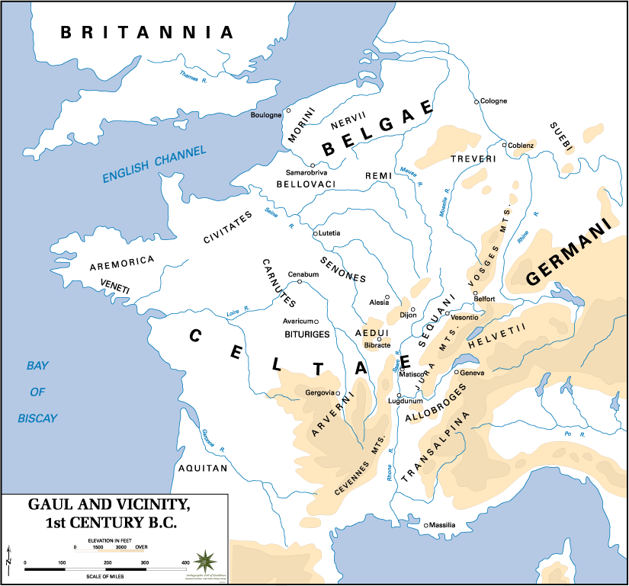
Notes:
Tribal homelands are vaguely specified.

Slide 22
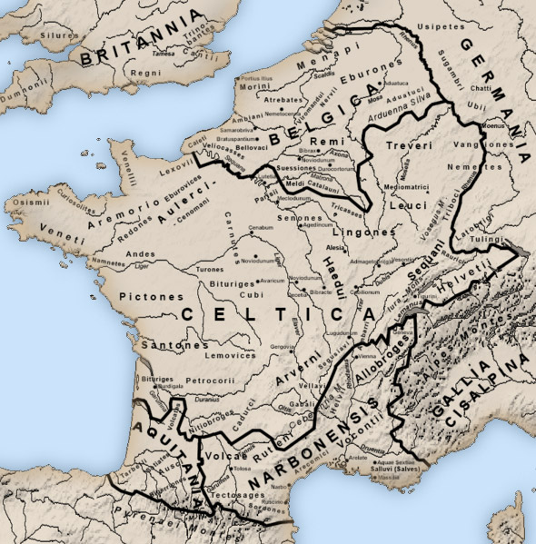
Notes:
Specified with boundaries.

Slide 23
The hard problem of vagueness
“Vagueness can be remedied by giving more accurate rules…”
What is the minimum height to count as ‘tall’?
6’0”
Given a definition of ‘tall’ as ‘at least 6 feet tall’, the hard problem is circumvented, but only by eliminating the vagueness of ‘tall’.

Slide 24
What is vagueness?
Notes:
At the outset, we face another problem of conceptual analysis!

Slide 25
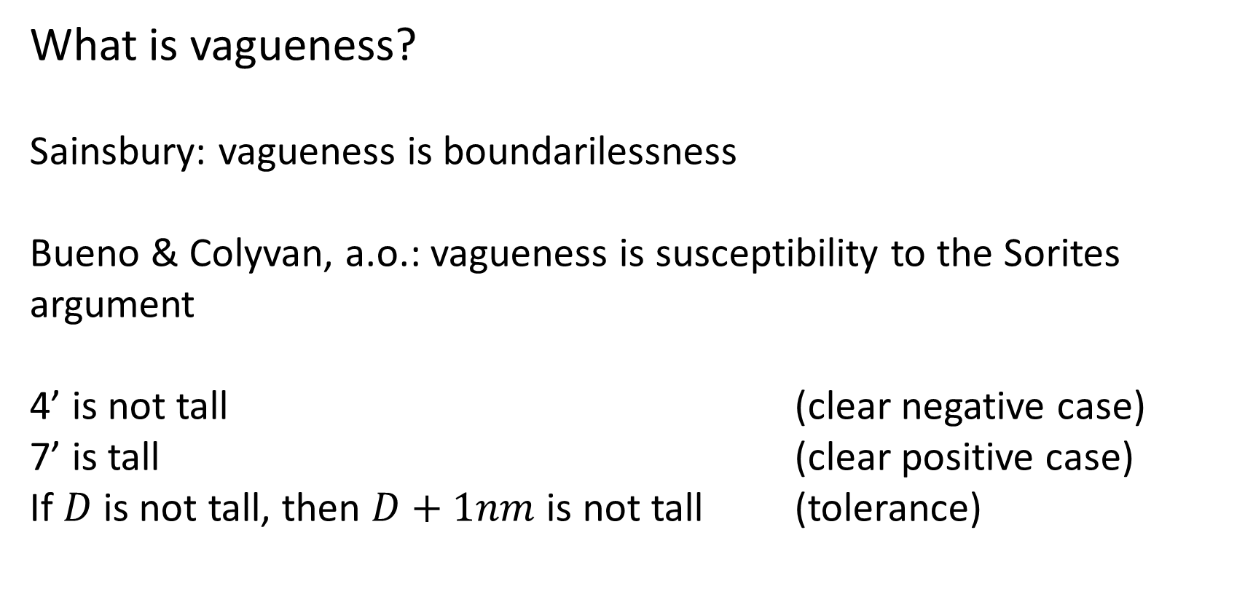
What is vagueness?
Sainsbury: vagueness is boundarilessness
Bueno & Colyvan, a.o.: vagueness is susceptibility to the Sorites argument
4’ is not tall (clear negative case)
7’ is tall (clear positive case)
If $D$ is not tall, then $D+1nm$ is not tall (tolerance)
Notes:
Sainsbury’s definition might “beg the question” against Epistemicism, but so does Bueno & Colyvan’s. For theirs to apply, the premises must at least “appear” true, but this intuition is not predicted by the epistemicist.
Instituting a boundary (between tall and not-tall) will falsify tolerance, so the two definitions are related.
Escaping the Sorites is related to the hard problem of vagueness, in that both take the existence of clear cases on both sides as premises. However, the conclusion of the Sorites can be eluded without addressing the hard problem (i.e. by placing a boundary somewhere).

Slide 26
Multi-dimensional vagueness
"The suggestion being that predicates like ‘is a religion’ are numerically) vague along a number of dimensions, such as belief in a deity (or deities), worship of the deity (or deities), belief in supernatural powers (usually associated with the deity), ritualistic behavior, and so on. Even if each of these dimensions has a natural numerical ordering, there is no non-trivial way of reducing these multiple numerical scales to a single numerical scale. In technical parlance, multi-dimensional vagueness (or non-numerical vagueness) has only a partial ordering, not a total ordering, associated with it." (Bueno & Colyvan 2012, fn.22)

Slide 27
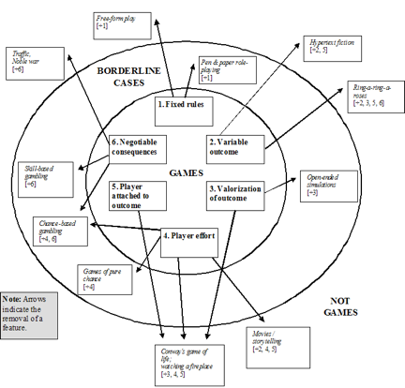
A game is:
1. a rule-based formal system with 2. a variable and quantifiable outcome, where
3. different outcomes are assigned different values,
4. the player exerts effort in order to influence the outcome,
5. the player feels attached to the outcome, and
6. the consequences of the activity are optional and negotiable.
(Juul 2003)
Notes:
We could imagine a Sorites series in which each step involves the weakening or failure of one factor among many.
NB: conditions (1)-(6) are not understood to be individually necessary and jointly sufficient.

Slide 28
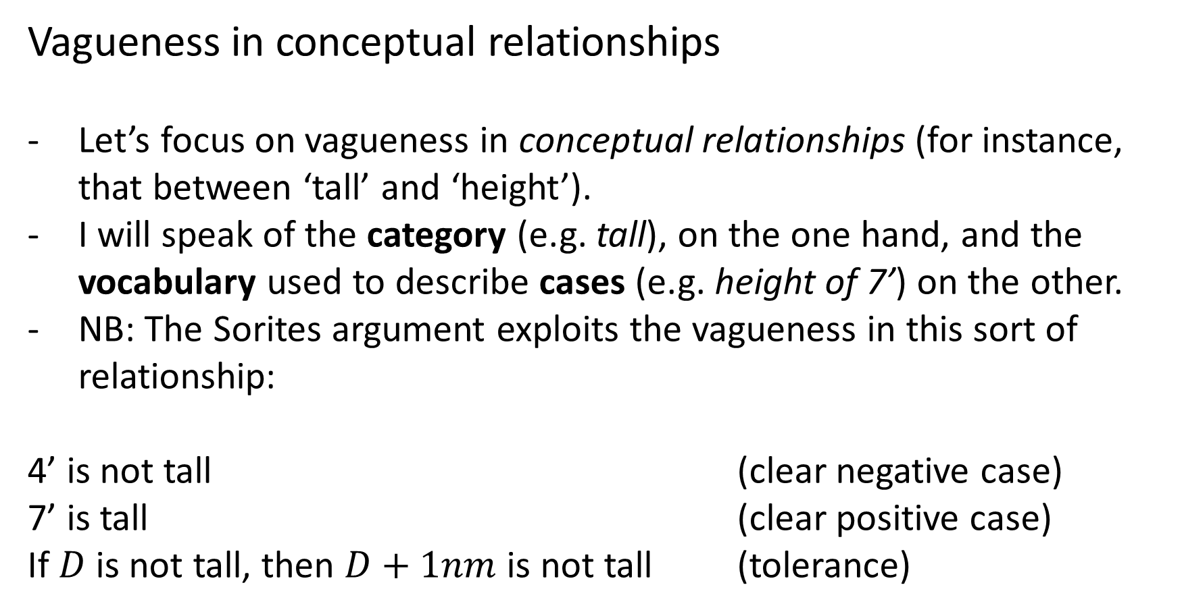
Vagueness in conceptual relationships
Let’s focus on vagueness in conceptual relationships (for instance, that between ‘tall’ and ‘height’).
I will speak of the category (e.g. tall), on the one hand, and the vocabulary used to describe cases (e.g. height of 7’) on the other.
NB: The Sorites argument exploits the vagueness in this sort of relationship:
4’ is not tall (clear negative case)
7’ is tall (clear positive case)
If $D$ is not tall, then $D+1nm$ is not tall (tolerance)
Notes:
This covers a lot of traditional cases, but not all (e.g. the map without borders).
By “exploits this sort of vagueness,” I mean that the Sorites would fall flat if the conceptual relationship were specifiable in a classical definition.

Slide 29
Vagueness in conceptual relationships
The hard problem of vagueness in the special case of vague conceptual relationships can be put as follows:
In such relationships, clear cases both in and out of the category can be described (in the “case vocabulary”).
The problem is to give a semantic theory that predicts those cases, without positing a falsely precise boundary (for instance, a classical definition of the category in the case vocabulary).

Slide 30
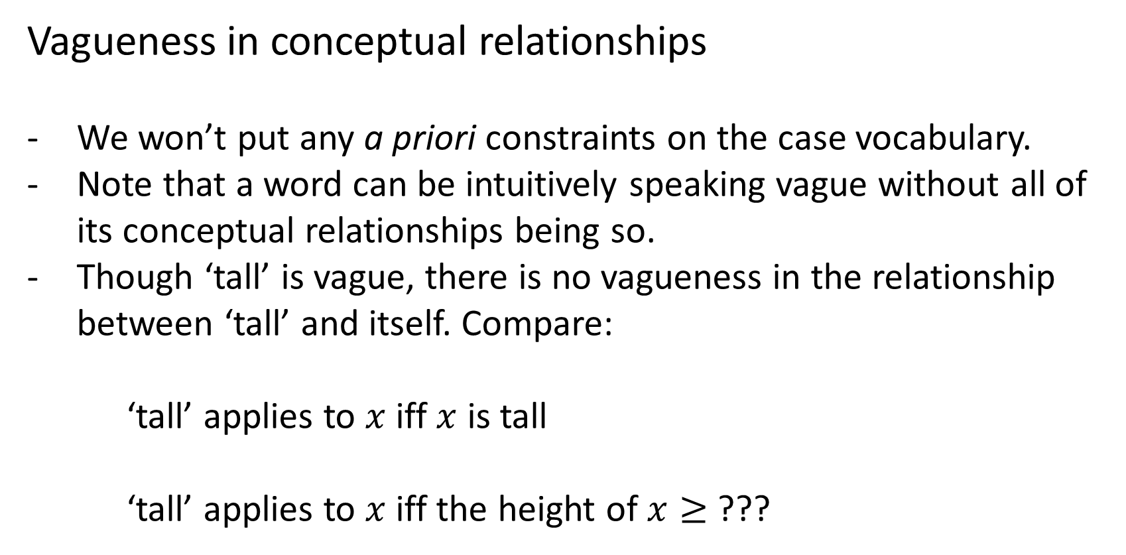
Vagueness in conceptual relationships
We won’t put any a priori constraints on the case vocabulary.
Note that a word can be intuitively speaking vague without all of its conceptual relationships being so.
Though ‘tall’ is vague, there is no vagueness in the relationship between ‘tall’ and itself. Compare:
‘tall’ applies to $x$ iff $x$ is tall
‘tall’ applies to $x$ iff the height of $x≥$ ???
Notes:
What does vague simpliciter mean? Perhaps that there is at least one analysis of the expression that is vague.

Slide 31
Why no boundary?
Boundaries exist in cases of explicit stipulation.
For instance, we can be infinitely precise about what values count as ‘greater than π’ because we have stipulated that ‘π’ denote the ratio of the circumference of a circle to its diameter.
By contrast, there has been no stipulation anchoring ‘tall’ to a particular minimum height.

Slide 32
Why no boundary?
If there is such a lower bound to ‘tall’, then it must exist because of a sort of implicit stipulation, inherent in the way we tend to use the word.
But there are problems with this idea of an implicit stipulation.

Slide 33
Why no boundary?
The use of a vague predicate tends to thin out as one gets closer to the intermediate region where a border would most plausibly occur.
In describing cases in that region, one tends to use an alternative descriptor – ‘tallish’, ‘somewhat tall’ – that is consistent with belonging or not belonging to the category proper (avoiding commitment on the issue).
If forced to choose between ‘tall’ and ‘not tall’, one is unsure and commits tentatively.
As a result, I would guess there is a lack of data from usage that directly indicates where the border should be drawn.
Notes:
- The first objection applies most strongly to a “first-order” border.

Slide 34
Why no boundary?
The problem with more indirect data is that it won’t determine a lower bound on its own. The data must be interpreted according to some scheme or other to justify a particular bound.
And just as we have never explicitly settled on a (first-order) bound for ‘tall’, nor have we settled on a (second-order) procedure for extracting a bound from the usage data for ‘tall’.

Slide 35
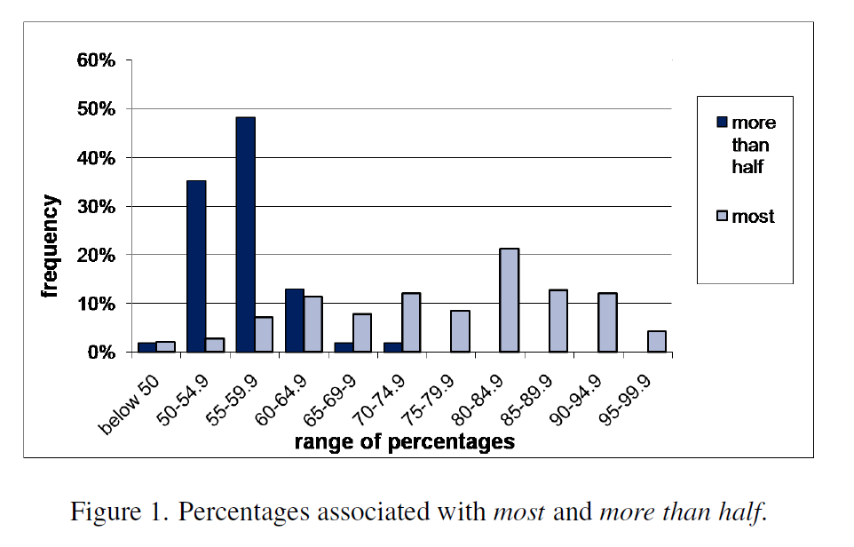
From Solt 2011
Notes:
Solt uses these data to illustrate a difference between ‘most’ and ‘more than half’, but consider using them instead to determine the precise conceptual relationship between ‘most’ and a numerical percentage.
NB: both expressions have some hits below 50%! Problem for MacFarlane’s view on which the extremal data points set the boundary.

Slide 36
Why no boundary? (Example: tall)
Suppose the usage data do indicate that the lower bound of ‘tall’ depends on the central tendency and dispersion of heights in a population (Solt 2010).
Suppose, however, that the data fail to indicate (independent of method of fit) whether the central tendency is to be understood as the mean, median or mode.
One is not ‘tall’ without significantly exceeding the central tendency, so the usage data would also have to yield the relevant (dispersion-based) measure of significance (e.g. one standard deviation).
Notes:
Whatever our question about the analysis, it seems we could design an experiment that creates usage data that would potentially answer the question, so what’s the problem?
This assumes that experimentally created usage data (i.e., roughly, the dispositions of competent speakers) could be the arbiter when it comes to such questions.
We saw reason to doubt this in the first lecture. Competent speakers pass a threshold of linguistic knowledge, but are not necessarily knowledgeable on the relevant point (and indeed, this is the kind of fine point that we would not expect them to have knowledge of).
There is also the concern, with new judgments – particularly forced choice judgments – that the precedent is being extended (uncertainly), rather than followed.

Slide 37
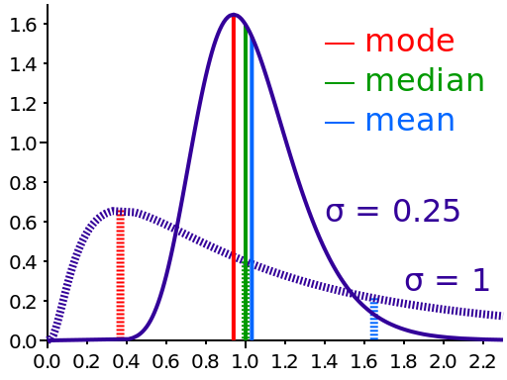

Slide 38
Why no boundary? (Example: tall)
In this case, we must settle what is to count as fitting the data before we can draw a conclusion about what bound has been implicitly stipulated.
But that issue seems just as unsettled as the first-order issue of where the lower bound of ‘tall’ lies.
It is not clear that the idea of an implicit stipulation has helped us here.

Slide 39
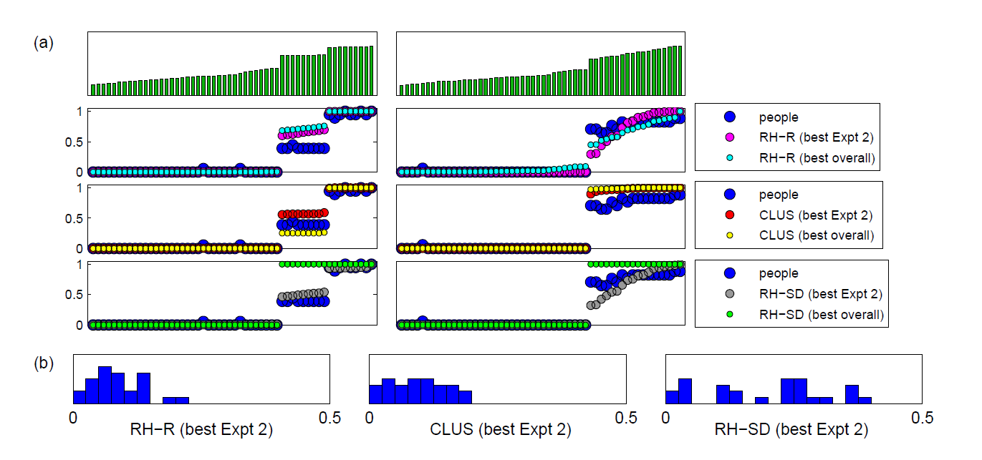
From Schmidt et al. 2009
Notes:
Schmidt et al. “It is not clear which model provides the best fit” out of CLUS and RH-R.

Slide 40
The hard problem of vagueness
How do we construct a semantic theory that successfully predicts the clear cases, but doesn’t include any false precision (in particular, doesn’t commit to any boundaries)?
The proposals in the vagueness literature generally succeed on the first part, but fail on the second.
Williamson’s (1994) epistemicism, supervaluationism, contextualism, tolerant logic, a.o., draw one or more bounds.
Sainsbury (1990) suggests avoiding drawing a boundary by giving a homophonic semantics, but thereby fails to make any predictions about cases described non-homophonically (e.g. it does not predict that seven-footers are tall).
Notes:
Note that a theory that merely says that ‘tall’ applies if one’s height exceeds the contextual standard does not yet predict that seven-footers count as ‘tall’. One must set the standard, and at that point, one is (arguably) guilty of false precision: how is it that the context settles the standard right there and not a nanometer either side?
A homophonic semantics does not amount to a semantic analysis of vagueness anyhow; the conceptual relationship it sets out to describe is a precise one.

Slide 41
What is a boundary?
4’
7’
Notes:
A classical analysis, which gives a necessary and sufficient condition (in the case vocabulary) for membership in a category, sets the boundary between membership and non-membership in the category.
Williamson posits a boundary of this sort, though he denies, in the case of vague predicates, that it can be known.

Slide 42
What is a boundary?
4’
7’
Notes:
A semantic theory in the supervaluationist mould draws two boundaries: a lower bound on the positive cases of ‘tall’, and an upper bound on the negative cases of ‘tall’.
These correspond to the cases that count as tall on every precisification, and on no precisification, respectively.
In between are the cases that could go either way.

Slide 43
What is a boundary?
A semantic boundary is a part of a theory of the meaning of an expression (hence “semantic”) that sorts cases into different objective statuses (e.g. in/out of the category; in on all precisifications/out on some precisifications).
Think of it as a total function on cases that maps them onto one status or the other.
When the relationship between the category and the case vocabulary is vague, semantic boundaries risk being empirically false, because overly precise.
Notes:
Show how an open ended list of sufficient conditions fails to draw a boundary, e.g. 7’ => tall, 6’11” => tall, 6’10” => tall, … .

Slide 44
The hard problem is hard
On the face of it, how could there be clear positive and clear negative cases without some sort of semantic boundary falling between them?
The hard problem falls into two parts:
Notes:
It seems that we could have some sufficient conditions (but not all: an open-ended list) – so no complete border – and yet the satisfaction of any one of those conditions would justify a positive judgment. This is a step on the way to where we’re going, except that we also need to do away with conditions that are necessary or sufficient, which are either themselves implausible, or don’t provide enough help with the phenomenon (e.g. the plausible condition: if one is 7’, one is tall).

Slide 45
7’

Slide 46
7’

Slide 47
7’

Slide 48
4’
Notes:
A classical analysis, which gives a necessary and sufficient condition (in the case vocabulary) for membership in a category, sets the boundary between membership and non-membership in the category.
Williamson posits a boundary of this sort, though he denies, in the case of vague predicates, that it can be known.

Slide 49
?
7’

Slide 50
The hard problem is hard
What justifies the determination of a (clear) case as positive (or negative), if not the comparison to a semantic boundary?
Suppose we begin with a clear case of ‘tall’ and successively consider cases that are shorter by increments as small as you like; we will eventually reach a case with a different status. The clear cases must give out somewhere – isn’t that place a semantic boundary?

Slide 51
Some answers

Slide 52
Some answers
What justifies the determination of a (clear) case as positive (or negative), if not the comparison to a semantic boundary?
The answer to (i) is that we judge a case internally, rather than by comparison to an external border.

Slide 54
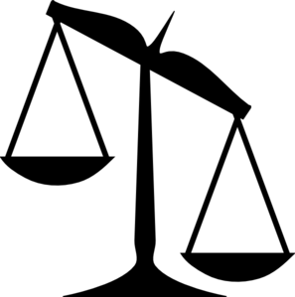

Slide 55
Some answers
We consider what features of the case are relevant to the question of membership in the category.
Next, we divide those considerations, or factors, into the positive and negative.
Finally, we weigh the relative importance of those factors to arrive at our judgment.
Since factors need not be generally necessary or sufficient (as opposed to merely sufficient in that case) to contribute to the decision, this process doesn't involve comparison to a border.

Slide 56
Some answers
Consider, for example, the following potted history of the term ‘planet’.
After the Copernican revolution, ‘planet’ was thought to apply to objects orbiting the sun.
The Earth and Jupiter both orbited the sun, and were considered planets in virtue of that fact.
The moon and the sun did not orbit the sun, and hence were not considered planets.

Slide 57
Some answers
But it couldn’t be that the meaning of ‘planet’ was such that orbiting the sun was generally sufficient to qualify.
Otherwise, we would have no hesitation including the asteroids in the belt between Mars and Jupiter in the category.
Instead, these were excluded, on the basis of the fact that they did not (with the exception of Ceres) have the spherical shape characteristic of other planets.
Hence, orbiting the sun is a positive factor in the application of planet, but is not a sufficient condition, since it can be overruled by the countervailing factor of non-spheroid shape.
Notes:
There has not been any counterexample yet to the necessity of orbiting the Sun, but that doesn’t mean there couldn’t be!
Also, if the condition were merely necessary, then we not have explained the initial judgments of the Earth and Jupiter.

Slide 58
Some answers
Now you might reply that the contribution orbiting the sun makes to the judgment that Jupiter is a planet is really that it is a conjunct in a more complex sufficient condition, namely orbiting the sun and being spheroid.
But even this is not so. The aforementioned Ceres, and more famously Pluto, are not considered planets, even though they satisfy that conjunction.
The meaning of ‘planet’, even prior to the definition given in 2006, did not include this as a sufficient condition, because we are not inclined to admit hundreds of trans-Neptunian objects satisfying it into the category.

Slide 59
Some answers
Instead, even the complex condition orbiting the sun and being spheroid counts only as a positive factor.
It is outranked by the negative condition doesn’t clear its own orbit which applies in the cases of Ceres and Pluto, but not in the case of the eight planets.

Slide 60
Some answers
Unlike necessary or sufficient conditions, whether one possesses a given factor is consistent, in principle, with any status whatsoever – the case could always include an even stronger factor for the opposite conclusion.
Hence factors do not mark borders.
Nevertheless, the weighing of factors, pro versus con, is all we need to decide a case!

Slide 61
Some answers
What about part (ii) of the hard problem? Won’t the place where the clear cases (of one sort) give out be a semantic boundary of some sort?
It can’t be denied that if the cases in a Sorites series are judged, and if cases at one end are judged as belonging to the category and cases at the other end are judged as not belonging, then there will be a step, as small as you like, that takes us from a case judged as not belonging to a case with a different status.
Notes:
- So in particular, if two cases 1cm apart are judged as cases to which ‘tall’ does and does not apply, respectively, then the border is effectively stipulated to lie in between the two cases.

Slide 62
Some answers
What may be denied, however, is that this step straddles a pre-existing semantic border, as opposed to one that was (speaking loosely) stipulated into place by the surrounding judgments.

Slide 63
4’
7’

Slide 64
4’
7’

Slide 65
4’
7’
Notes:
Considering the two new cases and judging them as positive and negative, respectively, will have the effect of narrowly pinning down the location of the boundary.

Slide 66
Some answers
What is implausible, of course, is that there is now a precise lower bound on a vague predicate like ‘tall’.
No-one denies that a precise border could be stipulated into existence for a vague predicate (thereby rendering the predicate precise).

Slide 67
Some answers
Moreover, judging two cases a small distance apart to have different semantic statuses would appear to create a precedent for semantic precision; indeed, this is just what we predict on the present account (homework exercise!).
So the notion that there will be a border after the cases are judged (as opposed to a prior one that guides the judging) is no objection.

Slide 68
Some answers
This border could be a temporary edifice, used by friends or collaborators; but if someone with appropriate authority were frogmarched through the series, it could end up being more permanent.
The latter situation might be exemplified by the demarcation of ‘planet’ and reclassification of Pluto which happened in 2006.

Slide 69
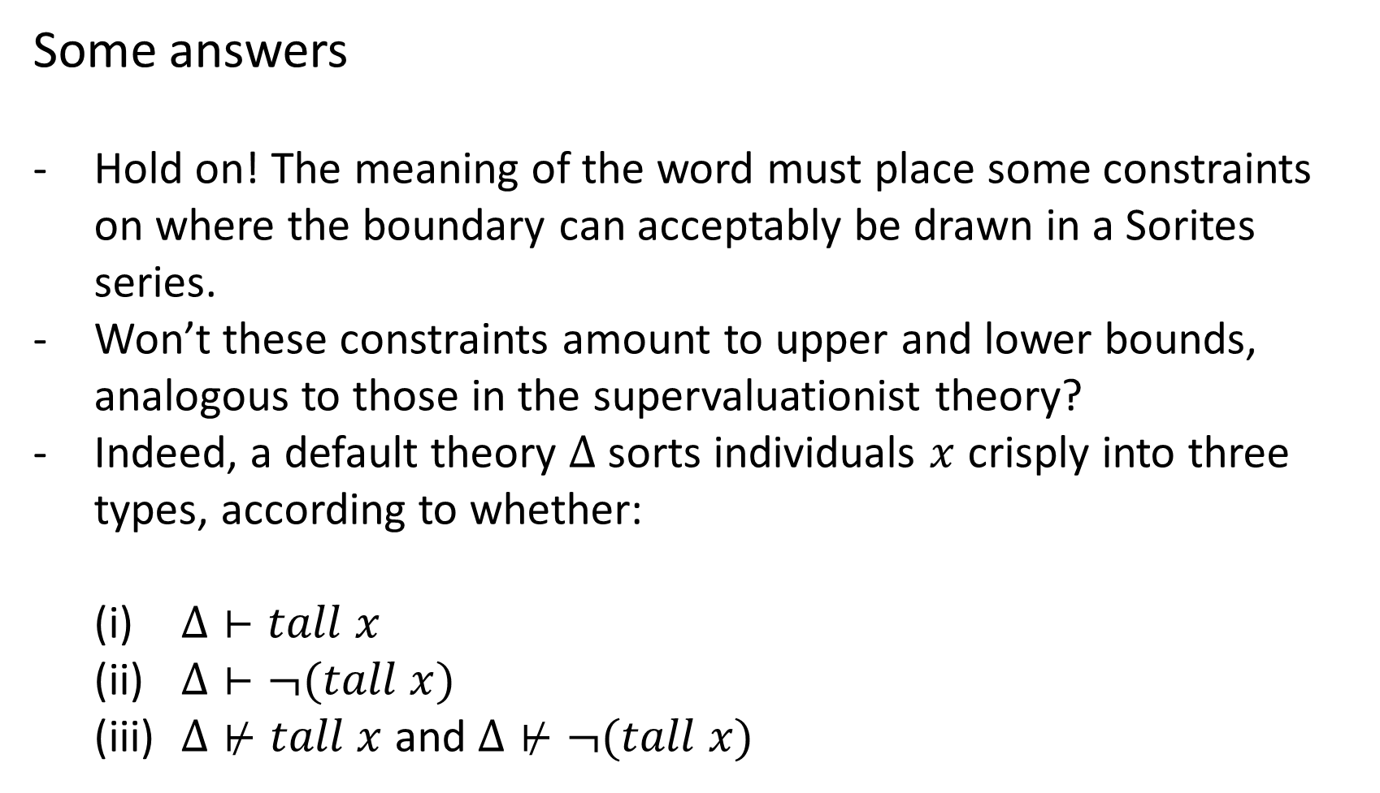
Some answers
Hold on! The meaning of the word must place some constraints on where the boundary can acceptably be drawn in a Sorites series.
Won’t these constraints amount to upper and lower bounds, analogous to those in the supervaluationist theory?
Indeed, a default theory $Δ$ sorts individuals $x$ crisply into three types, according to whether:
    $Δ⊢tall x$
    $Δ⊢¬(tall x)$
    $Δ⊬tall x$ and $Δ⊬¬(tall x)$

Slide 70
4’
7’

Slide 71
Some answers
Cases where the verdict depends on an unsettled comparison are in a sense “open”; they may be rationally resolved either way.
Such cases contrast with what we have been calling “clear cases,” where the semantic precedent mandates a particular judgment.
The clear cases “give out” at the border with the open cases.

Slide 72
clear case
open case
4’
7’

Slide 73
Some answers
In supervaluationism, the set of precisifications represents the word’s meaning.
Hence, supervaluationist models do encode semantic boundaries, and fail to offer a solution to the hard problem of vagueness.

Slide 74
Some answers
In supervaluationism, the set of precisifications represents the word’s meaning.
Hence, supervaluationist models do encode semantic boundaries, and fail to offer a solution to the hard problem of vagueness.
On the present theory, the perspective from which some judgments are rationally constrained while others are left open is not supposed to represent the word’s meaning.

Slide 75
Some answers
To start with, I have been assuming that the predicate itself makes a binary distinction, between those cases to which it applies and those to which it doesn’t (in/out).
Instead, these boundaries form a tripartite distinction (in/open/out).

Slide 76
Some answers
Since judgments in open cases help decide the meaning of the word, we are forced to distinguish the meaning from the particular perspective from which that meaning is judged.
Consider a case that starts off open, but later is judged to belong to the category.

Slide 77
4’
7’

Slide 78
4’
7’

Slide 79
Some answers
If “open” were a sort of semantic status, then the judgment (classifying it as “out”) would simply be false!
Indeed, there would have been no need for a judgment call; one would be rationally constrained to call it “open,” if that were its actual status.

Slide 80
Some answers
So the trick to solving the hard problem of vagueness is to realise that “clear case” is not a semantic status as such.
It is not specified by the meaning of a predicate like ‘tall’.
Instead, it is a status that relates a case to a particular judgment situation.

Slide 81
Some answers
Where the clear cases give out tells you about what can be rationally determined about the meaning of the predicate from the perspective of a particular situation of judging.
A judgment situation, set out in a precise way, determines boundaries between different sorts of case.
But these do not mark semantic boundaries in the predicate.
This, btw, is my answer to the question we had earlier about whether the factor-based presentation of the Atlantic’s definition of ‘sandwich’ represented the meaning of ‘sandwich’ (the answer is ‘no’; it only captures their perspective on the meaning).

Slide 82
Some answers
And the idea that the judgment situation, rather than the predicate, draws a boundary is unobjectionable.
As long the grounds for judgment are established in a perspicuous way, then it stands to reason that we can sort cases into those for which a particular judgment is rationally required (the “clear cases”), and those for which no particular judgment is rationally required (the “open” ones).

Slide 83
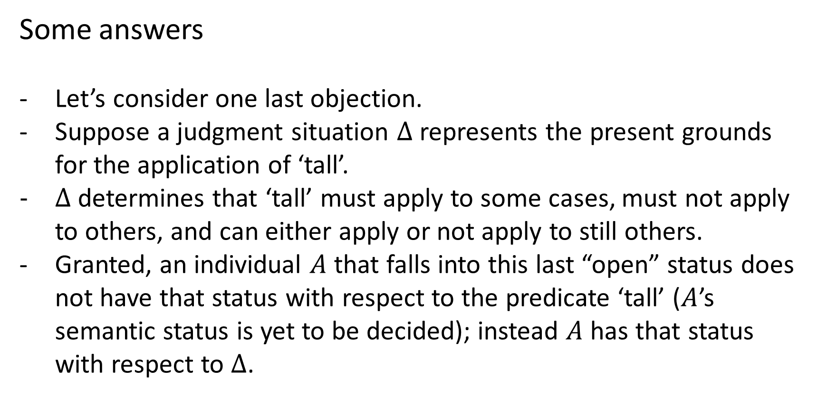
Some answers
Let’s consider one last objection.
Suppose a judgment situation $Δ$ represents the present grounds for the application of ‘tall’.
$Δ$ determines that ‘tall’ must apply to some cases, must not apply to others, and can either apply or not apply to still others.
Granted, an individual $A$ that falls into this last “open” status does not have that status with respect to the predicate ‘tall’ ($A$’s semantic status is yet to be decided); instead $A$ has that status with respect to $Δ$.

Slide 84
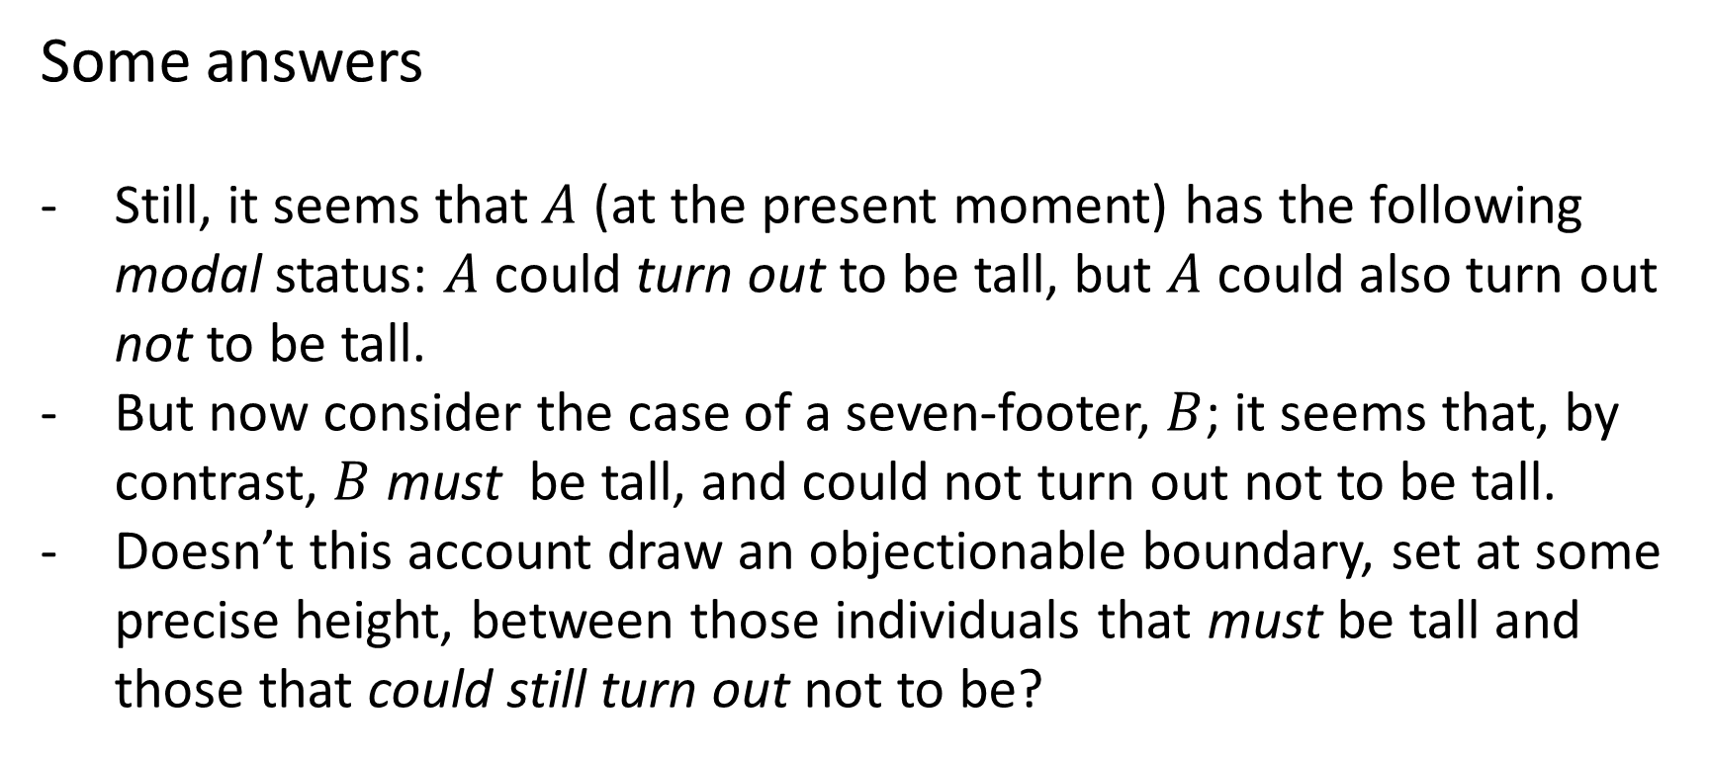
Some answers
Still, it seems that$A$ (at the present moment) has the following modal status: $A$ could turn out to be tall, but $A$ could also turn out not to be tall.
But now consider the case of a seven-footer, $B$; it seems that, by contrast, $B$ must be tall, and could not turn out not to be tall.
Doesn’t this account draw an objectionable boundary, set at some precise height, between those individuals that must be tall and those that could still turn out not to be?

Slide 85
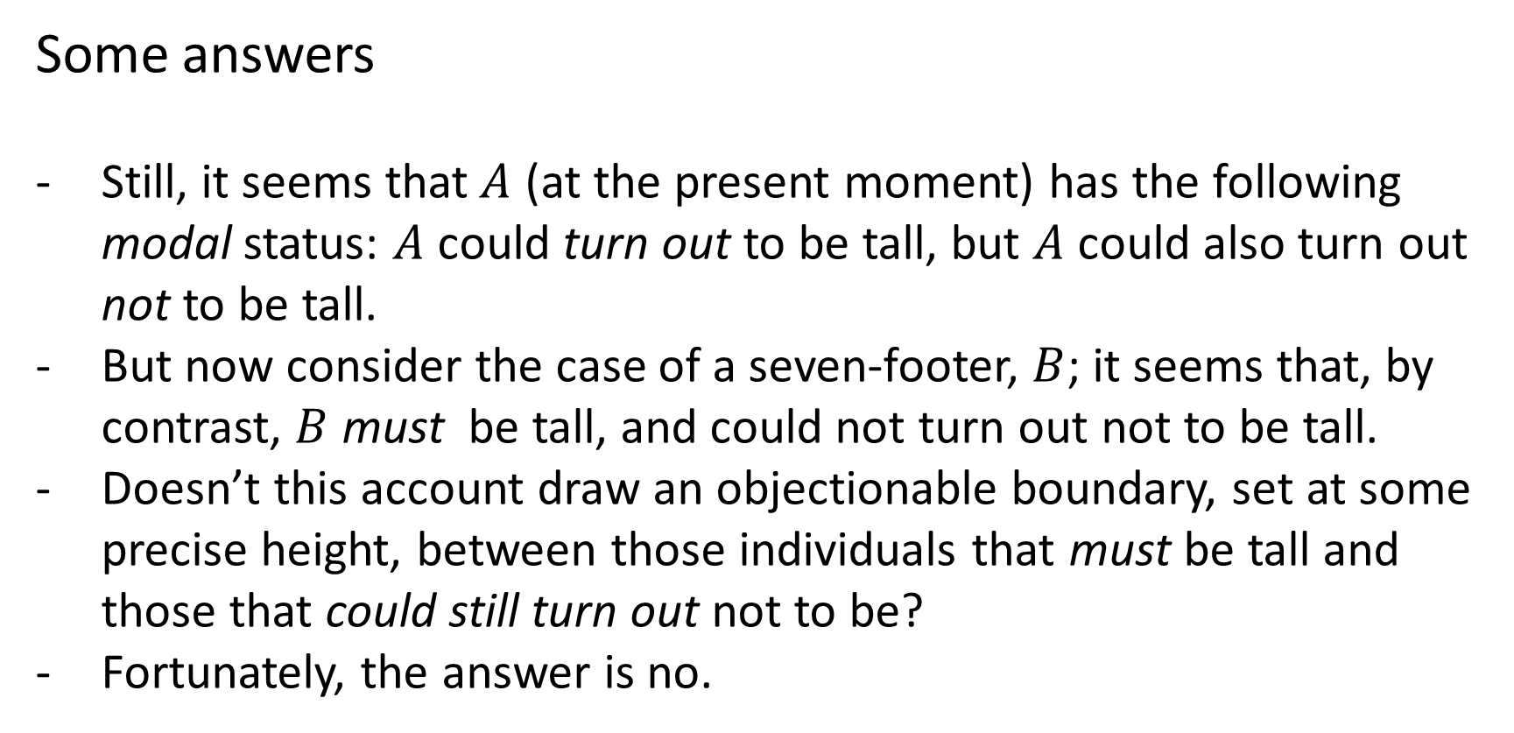
Some answers
Still, it seems that$A$ (at the present moment) has the following modal status: $A$ could turn out to be tall, but $A$ could also turn out not to be tall.
But now consider the case of a seven-footer, $B$; it seems that, by contrast, $B$ must be tall, and could not turn out not to be tall.
Doesn’t this account draw an objectionable boundary, set at some precise height, between those individuals that must be tall and those that could still turn out not to be?
Fortunately, the answer is no.

Slide 86
Some answers
Even though it is a clear case from the present perspective, even the seven-footer could turn out not to be tall!
All cases have the same modal status as our open case A.

Slide 87
Some answers
Consider the case of a man with only one normal-sized hair left on his head. A clear case of ‘bald’. Could he turn out not to be bald?’
Well, yes. As it happens, there are semanticists who propose this as his present status, considering having no hair to be the proper criterion of baldness (Burnett 2012).
If this seems implausible, compare it to the claims that there are no concrete examples of circles or straight lines; they only exist in the abstract realm of plane geometry.
It seems a category may end up so refined as to fail to apply to any concrete cases.
Notes:
Wrinkle: ‘bald’ is an absolute adjective, while ‘tall’ is a relative one.
Still, the point is that clear cases might be reclassified, not that ‘tall’ might not apply to anything concrete.

Slide 88
Some answers
It is clear, anyway, that even previously settled cases are not unassailable.
Even a clear case is judged from the perspective of a judgment situation that is provisional.
Any judgment situation could be expanded in the future so as to overturn a previous decision.
A case in point is Pluto, a once settled case of a planet that was latterly determined not to be one.

Slide 89
Some answers
As mentioned earlier, the judgment situation for ‘planet’, which had classified Pluto as a clear case, was later expanded to include not clearing its orbit as a negative factor.
Moreover, not clearing its orbit was stipulated to be stronger than the strongest factor in favour of Pluto being a planet (namely, that it orbits the sun and has sufficient mass to assume a nearly round shape).

Slide 90
Some answers
The Solar System is like a big Sorites series for the predicate ‘planet’, going from Jupiter down to flecks of space dust.
The discoveries of more and more Trans-Neptunian objects similar to Pluto forced the authorities to take into account new factors that would differentiate the members of the series, and forestall the ushering in of hundreds of new planets.
The controversial solution was to take into account whether a body had cleared its orbit.
A side-effect of this was to reclassify Pluto as a non-planet.

Slide 91
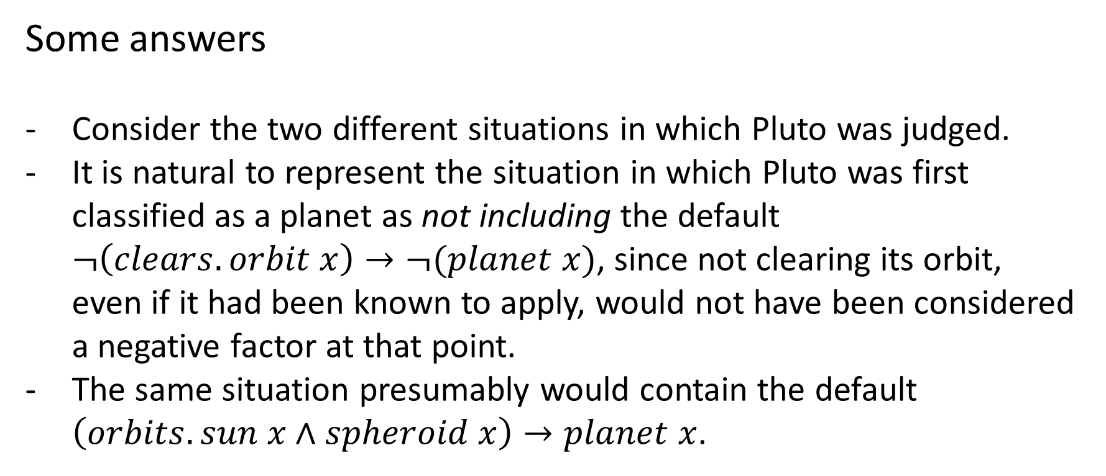
Some answers
Consider the two different situations in which Pluto was judged.
It is natural to represent the situation in which Pluto was first classified as a planet as not including the default $¬\left(clears.orbit x\right)→¬(planet x)$, since not clearing its orbit, even if it had been known to apply, would not have been considered a negative factor at that point.
The same situation presumably would contain the default $\left(orbits.sun x∧spheroid x\right)→planet x$.

Slide 92
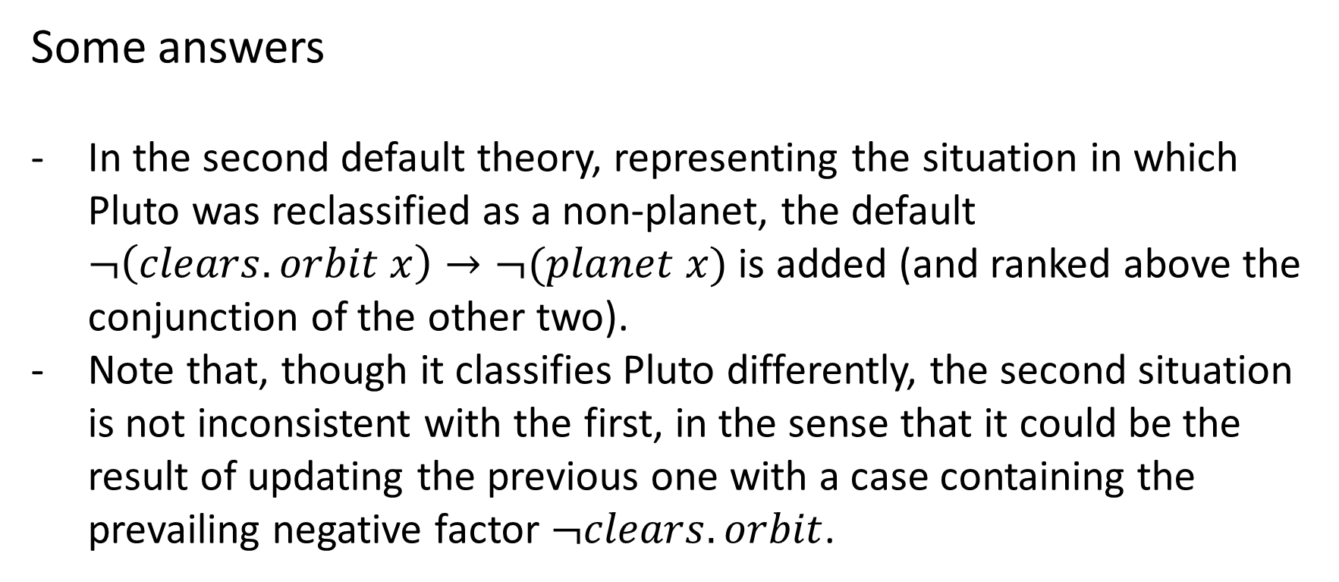
Some answers
In the second default theory, representing the situation in which Pluto was reclassified as a non-planet, the default $¬\left(clears.orbit x\right)→¬(planet x)$ is added (and ranked above the conjunction of the other two).
Note that, though it classifies Pluto differently, the second situation is not inconsistent with the first, in the sense that it could be the result of updating the previous one with a case containing the prevailing negative factor $¬clears.orbit$.

Slide 93
Conclusion
The hard problem of vagueness had two parts.
Part (i) was to give an account of classification that did not require the category to have a border.
Our account relied instead on identifying and comparing the factors pro and con.
Factors were features of the case that were individually consistent with any classification, and hence could not be construed as boundaries or components thereof.

Slide 94
Conclusion
Part (ii) was to account for the fact that clear cases (of the positive type, say) must give out (somewhere before they meet the clear cases of the negative type) without introducing a semantic boundary.
We infer that the clear cases must give out from the fact that, on pain of endorsing a paradoxical conclusion, the positive cases themselves must give way to the negative.
But we noted that the point where this occurs, though the last positive case may be as close as you like to a negative case, need not correspond to a pre-existing semantic border, as opposed to one stipulated into existence by the judgments in the series itself.

Slide 95
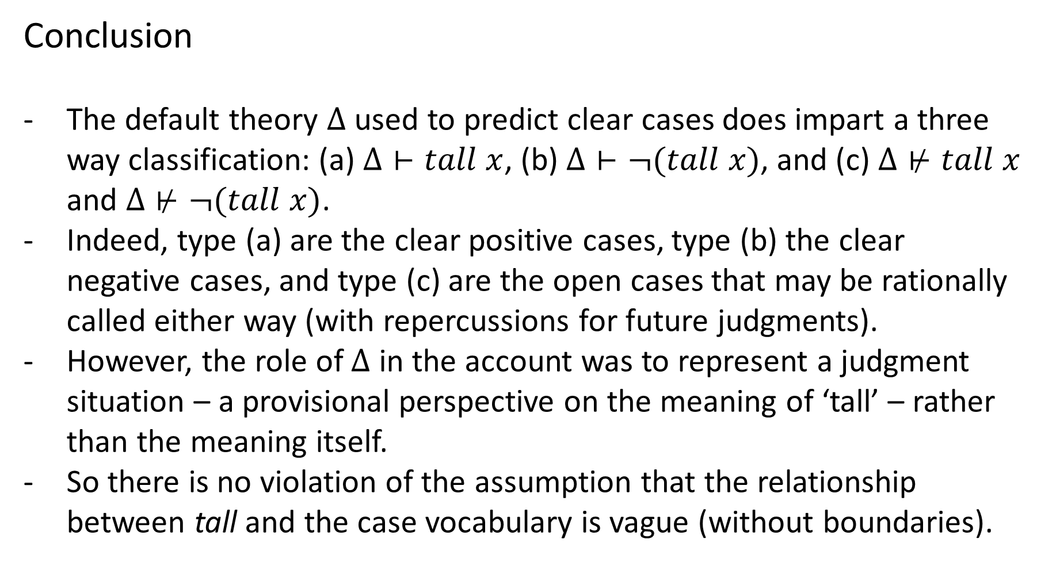
Conclusion
The default theory $Δ$ used to predict clear cases does impart a three way classification: (a) $Δ⊢tall x$, (b) $Δ⊢¬(tall x)$, and (c) $Δ⊬tall x$ and $Δ⊬¬(tall x)$.
Indeed, type (a) are the clear positive cases, type (b) the clear negative cases, and type (c) are the open cases that may be rationally called either way (with repercussions for future judgments).
However, the role of $Δ$ in the account was to represent a judgment situation – a provisional perspective on the meaning of ‘tall’ – rather than the meaning itself.
So there is no violation of the assumption that the relationship between tall and the case vocabulary is vague (without boundaries).

Slide 96
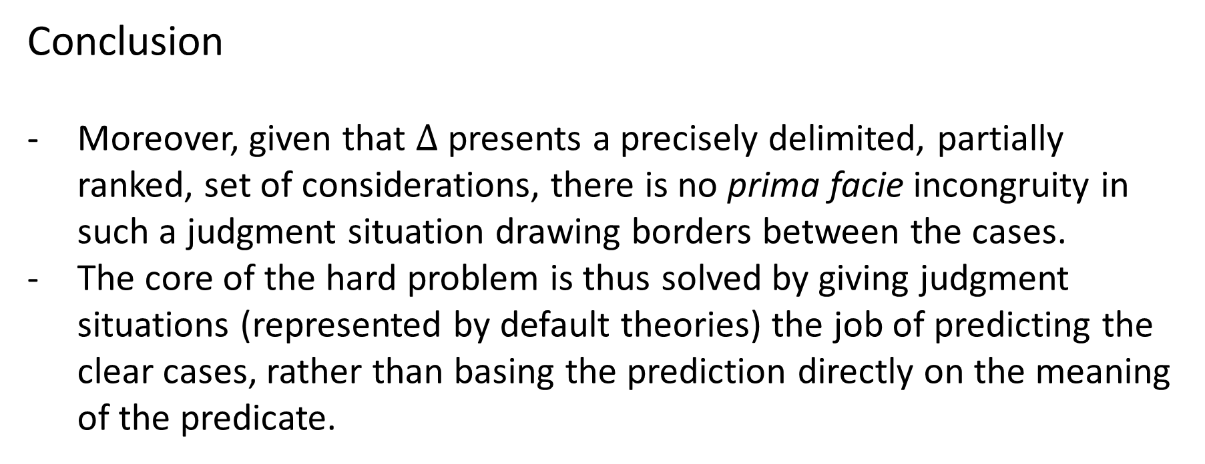
Conclusion
Moreover, given that $Δ$ presents a precisely delimited, partially ranked, set of considerations, there is no prima facie incongruity in such a judgment situation drawing borders between the cases.
The core of the hard problem is thus solved by giving judgment situations (represented by default theories) the job of predicting the clear cases, rather than basing the prediction directly on the meaning of the predicate.

Slide 97
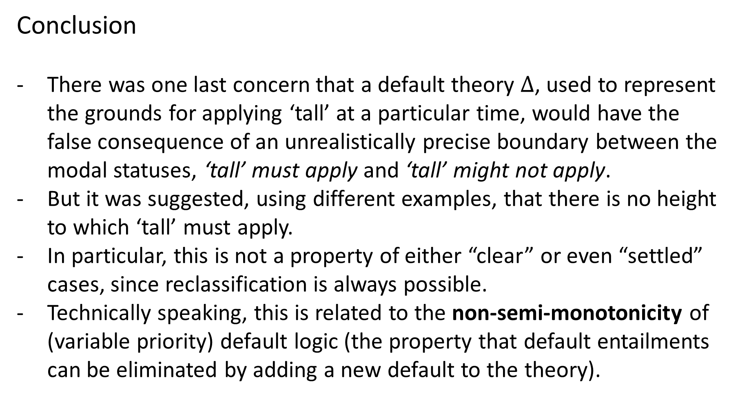
Conclusion
There was one last concern that a default theory $Δ$, used to represent the grounds for applying ‘tall’ at a particular time, would have the false consequence of an unrealistically precise boundary between the modal statuses, ‘tall’ must apply and ‘tall’ might not apply.
But it was suggested, using different examples, that there is no height to which ‘tall’ must apply.
In particular, this is not a property of either “clear” or even “settled” cases, since reclassification is always possible.
Technically speaking, this is related to the non-semi-monotonicity of (variable priority) default logic (the property that default entailments can be eliminated by adding a new default to the theory).

Slide 98
Bibliography
Burnett, H. 2012. The Grammar of Tolerance: On Vagueness, Context-Sensitivity, and the Origin of Scale Structure. UCLA Linguistics.
Schmidt, L., N. Goodman, D. Barner, J. Tenenbaum. 2009. How Tall Is Tall? Compositionality, Statistics, and Gradable Adjectives.
Solt, Stephanie. 2010. Notes on the comparison class. In Rick Nouwen, Robert van Rooij, Uli
Sauerland and Hans-Christian Schmitz (eds.), Vagueness in communication (ViC2009), LNAI 6517,
189–206. Berlin, Heidelberg: Springer Verlag
Solt, Stephanie. 2011. Vagueness in Quantity: Two Case Studies from a Linguistic Perspective.

