Slide 1
Analysis by Default
NASSLLI 2016
Rutgers, New Jersey

Slide 2
Schedule
Today
Conceptions and criticisms of analysis
Tuesday and Wednesday
Common law constraint, default logic, coding constraint into default logic
Thursday
Vagueness
Friday
Subjectivity
Notes:
Readings on the website

Slide 3
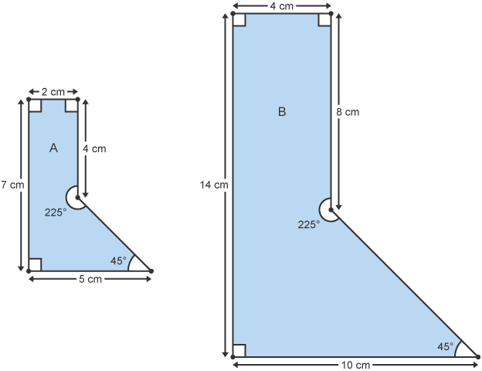
Example (similar figure)

Slide 4
Example (similar figure)
Figure A is similar to figure A’
.=.
The ratio of the distance between any two points P, Q, on A and the distance between the corresponding points P’, Q’ on A’ is constant. Df.
Notes:
An analysis is a statement.

Slide 5
Example (similar figure)
Figure A is similar to figure A’
.=.
The ratio of the distance between any two points P, Q, on A and the distance between the corresponding points P’, Q’ on A’ is constant. Df.
analysandum
analysans

Slide 6

Example (chair)

Slide 7
Example (chair)
A chair
is
a seat with a back and four legs, for one person to sit on.
Notes:
Too strict? How? Too lax? How?
Is it circular? Could we in turn explicate ‘seat’ and ‘back’ and ‘leg’ without mentioning ‘chair’?

Slide 8
Example (most)
Most N
means
more than half of N
Notes:
Application to linguistics (lexical semantics)

Slide 9
Example (knowledge)
Knowledge
is
justified true belief
Notes:
Application to philosophy (conceptual analysis)

Slide 10
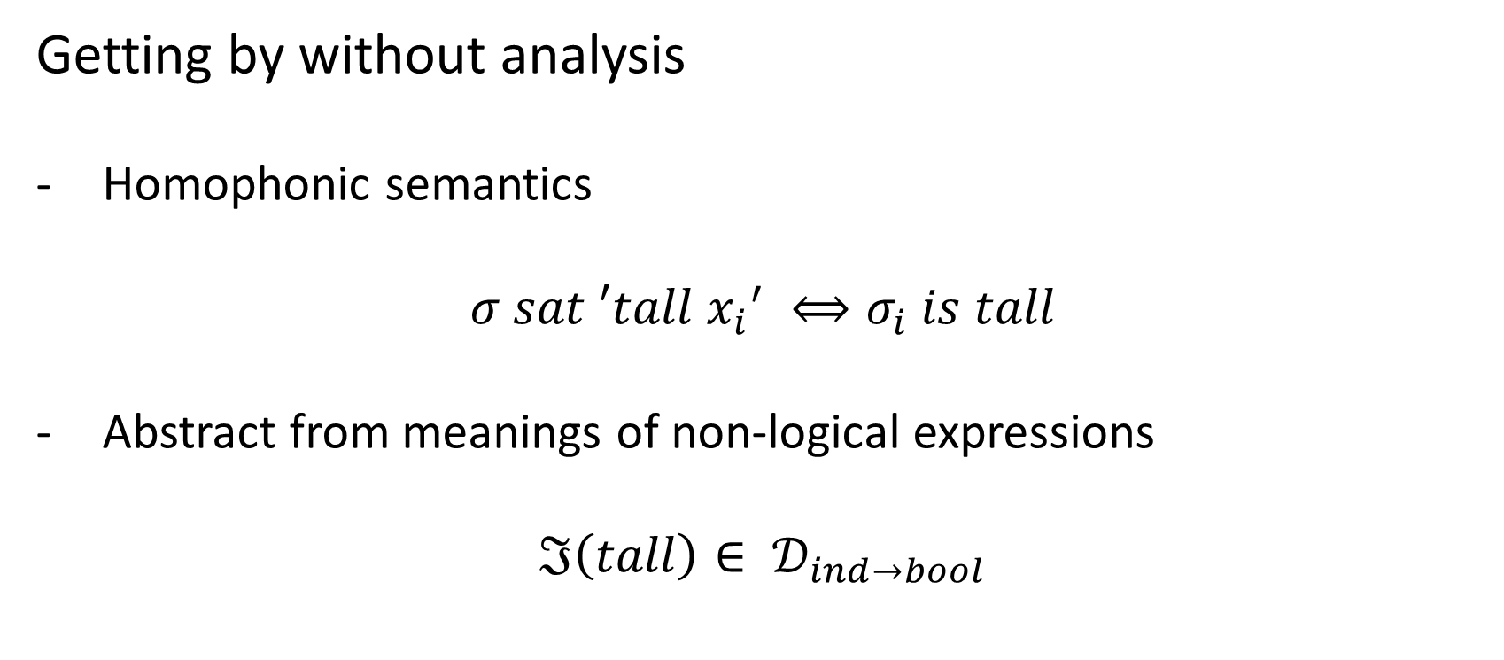
Getting by without analysis
Homophonic semantics
$$σ sat ′tall {x_{i}}^{′} ⟺σ_{i} is tall$$
Abstract from meanings of non-logical expressions
$$ℑ\left(tall\right)∈ 𝒟_{ind→bool}$$

Slide 11
Why analyse?
Distinguish different senses of a word
Distinguish different senses of a word in different dialects
Distinguish different senses of a word over time
Examine disputes over meaning
Multidimensionality
Notes:
The existence of analyses would make these straightforward or tractable; not impossible on a homophonic semantics, however.

Slide 12
Ambiguity
H₂O is water
Ice is H₂O
---------------------
Ice is water

Slide 13
Ambiguity
H₂O is water_{sense-1}
Ice is H₂O
---------------------
Ice is water_{sense-2}

Slide 14
Dialectical difference
In Australian English, a hamburger is not a sandwich.
In American English, a hamburger is a sandwich.

Slide 15
Meaning change
Eighteenth-century meanings of English words:
candour means, not frankness, but good-will, kindness
discover, often not find, but reveal, disclose
disgusting, not repulsive, but distasteful, boring
meat, not necessarily flesh, but food in general
sentiments, not feelings, but thoughts
want, not desire, but lack

Slide 16
Semantic conflict
‘Is a hotdog/ramen burger/tuna melt a sandwich?’

Slide 17
Semantic conflict
‘Is Secretariat an athlete?’ (Ludlow 2011)

Slide 18
Semantic conflict
‘Is Secretariat an athlete?’ (Ludlow 2011)
pro: ran 1.5 miles in 2:24 (37.5 mph)

Slide 19
Semantic conflict
‘Is Secretariat an athlete?’ (Ludlow 2011)
pro: ran 1.5 miles in 2:24 (37.5 mph)
con: is a horse
Notes:
Argument over the analysis of ‘athlete’. Should it exclude non-humans?

Slide 20
Multidimensionality
Which line is curvier?

Slide 21
Criticisms of analysis
There is no criterion for an analytical statement (i.e. there is no analysis of analysis).
There is no analytic/synthetic distinction (Quine).
Outside of abbreviatory conventions in, e.g., mathematics, a true definition (one without counterexamples) has never been given.
Empirical concepts don’t have definitions (Waismann).

Slide 22
Which statements are analytic?

Slide 23
Which statements are analytic?
Bachelors are unmarried.
Bachelors are untidy.

Slide 24
Which statements are analytic?
Bachelors are unmarried.
Bachelors are untidy.
(cf. Ascetics have matted hair; Bachelors don’t wear a wedding ring.)
Notes:
The analytic statement has no exceptions. But even if there were exceptions, we would not be inclined to take it as analytic.

Slide 25
Which statements are analytic?
Bachelors are unmarried.
Bachelors are untidy.
(cf. Ascetics have matted hair; Bachelors don’t wear a wedding ring.)
A chair has a back.
A chair was addressed by Clint Eastwood in a performance piece at the 2012 Republican Political Convention.

Slide 26
Which statements are analytic?
Those known by any competent speaker of the language.
Those known by anyone competent with the expression.

Slide 27
Which statements are analytic?
Those known by any competent speaker of the language.
Those known by anyone competent with the expression.
Paradox of analysis
How could an analysis ever be “news”?
Open question argument (G. E. Moore)
‘It is good, but is it pleasure?’
Insofar as the question is open, there are two distinct concepts.

Slide 28
Competent with the language
M. Jour. ... I must tell you something. I am in love with a person of high estate, and I would like you to help me to write something to her in a billet-doux, which I propose to let fall at her feet.
Teach. Very good.
M. Jour. Something very gallant.
Teach. Certainly. Do you wish to write in verse?
M. Jour. No, no, no verses.
Teach. You only want prose?
M. Jour. No. I do not want either prose or verse.
Teach. It must really be either one or the other.
M. Jour. Why?
Teach. Because, monsieur, one can only express oneself in prose or verse.
M. Jour. Is there nothing but prose or verse?
Teach. No, monsieur: all that is not prose is verse; and all that is not verse is prose.
M. Jour. And what is it when one speaks?
Teach. Prose.
M. Jour. What? when I say, “Nicole, bring me my slippers, and give me my nightcap,” is that prose?
Teach. Yes, monsieur.
M. Jour. Upon my word! I have spoken prose for more than forty years without knowing anything about it…
Notes:
Moliere’s Le Bourgeois Gentilhomme; conversation between Monsieur Jourdain and the Teacher of Philosophy.

Slide 29
Competent with the expression
Soc. … What is piety, and what is impiety?
Euth. Piety is doing as I am doing; that is to say, prosecuting anyone who is guilty of murder, sacrilege, or of any other similar crime and not to prosecute them is impiety.
Soc. But ... I would rather hear from you a more precise answer, which you have not as yet given, my friend, to the question, What is ‘piety’? When asked, you only replied, Doing as you, charging your father with murder.
Euth. And what I said was true, Socrates.
Soc. No doubt, Euthyphro; but you would admit that there are many other pious acts?
Euth. There are.
Soc. Remember that I did not ask you to give me two or three examples of piety, but to explain the general idea which makes all pious things to be pious. Do you not recollect that there was one idea which made the impious impious, and the pious pious? Tell me what is the nature of this idea, and then I shall have a standard to which I may look.
Euth. I will tell you, if you like.
Soc. I should very much like.
Euth. Piety, then, is that which is dear to the gods, and impiety is that which is not dear to them.
Soc. Very good, Euthyphro; you have now given me just the sort of answer which I wanted. But whether what you say is true or not I cannot as yet tell, although I make no doubt that you will prove the truth of your words.
Notes:
Plato’s Euthyphro dialogue

Slide 30
Competent with the expression
Euthyphro is competent with the expression ‘piety’; for instance, he can adduce plausible cases.
But Socrates is not satisfied with the analysis he offers:
Piety is that which is dear to the gods
Notes:
Understanding to what the term applies vs. articulating an analysis

Slide 31
Competent with the expression
When Astronomer Mike Brown asked people for the meaning of ‘planet’, the analyses he got were “scientifically misguided”:
large rocky bodies in the solar system (well no, there are gas giants), things with moons (not Mercury or Venus!), things that are big enough to see with your eye (Uranus, Neptune and Pluto are out), things that pull the earth around in its orbit (that's just the Sun).
But when he asked people to name the planets, everyone gave the same answer, starting with Mercury and ending with Pluto.

Slide 32
Competent with the expression (analysis)
Competent users may not have memorized the definition (of ‘similar figure’ or ‘planet’).
Competent users may not be able to extract a general definition from their robust understanding of particular cases.

Slide 33
Competent with the expression (cases)
Competent users can differ on particular cases (such as Secretariat).
Competent users can be ignorant about particular cases (does 6’ count as tall?).
Competent users can be wrong about particular cases (Pluto is a planet).
Hence they do not always know to what things the term can be applied correctly.

Slide 34
Which statements are analytic?
Those that are non-contingent.
Notes:
Philosophers have taken analyticity to be a source/explanation of necessity.
We can try to use necessity as a criterion of analyticity.

Slide 35
Non-contingency
A circle is a plane figure, every point of which is equidistant from a fixed point.

Slide 36
Non-contingency
A circle is drawn on this page.
Notes:
Cf. Bachelors are untidy.

Slide 37
Non-contingency
A circle is drawn on this page.

Slide 38
Non-contingency
A circle is drawn on this page. (accident)

Slide 39
Non-contingency
A circle is a plane figure, every point of which is equidistant from a fixed point. (definition)
Necessarily, a circle is a plane figure, every point of which is equidistant from a fixed point.

Slide 40
Non-contingency
A circle has the maximum area for a given perimeter.

Slide 41
Non-contingency
A circle has the maximum area for a given perimeter. (property)
Necessarily, a circle has the maximum area for a given perimeter.
Notes:
NB: singular indefinite generic; but as Cohen points out, ‘circle’ could be defined this way.

Slide 43
Non-contingency
A chair has a back.

Slide 44
Non-contingency
A chair has a back.
Necessarily, a chair has a back.

Slide 45

Non-contingency
A chair has a back.
Necessarily, a chair has a back.

Slide 46
Which statements are analytic?
Those known by any competent speaker of the language.
Those known by anyone competent with the expression.
A competent speaker is one who knows a language to a satisfactory degree.
One competent with an expression knows its meaning to a satisfactory degree.
A natural language is a system of conventions that specify the meanings, and certain other properties, of a set of expressions.
Notes:
Roundabout way of talking about the subject matter known – meaning.
E-language, rather than I-language.

Slide 47
Which statements are analytic?
Those that explicate the meaning of a term.

Slide 48
Which statements are analytic?
Those that explicate the meaning of a term.
While ascetics may be recognized by their matted hair, having matted hair is not part of the meaning of ‘ascetic’.

Slide 49
Which statements are analytic?
A predicate has an application condition determined by linguistic convention.
When a predicate applies to an object, it is due to the fact that the features of the object satisfy the application condition.
When ‘ascetic’ applies to someone, it is never (even in part) due to the fact that they have matted hair.
When ‘chair’ applies to something, it may be due (in part) to the fact that it has a back.

Slide 50
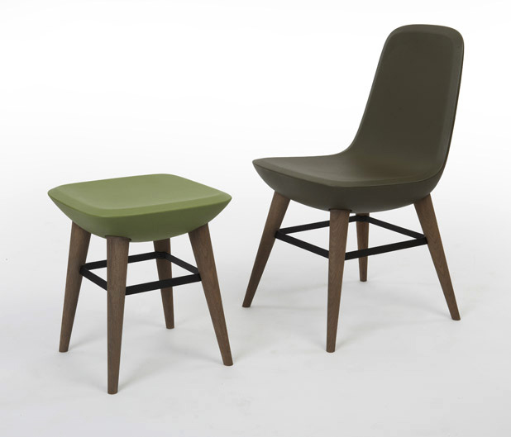
Notes:
This claim has a visual demonstration.

Slide 51
Which statements are analytic?
‘An F is G’ is analytic iff whether ‘F’ applies to an object sometimes depends on whether it is G.
‘An F is G’ is analytic iff being G is a consideration in the application of ‘F’.

Slide 52
Which statements are analytic?
Singular indefinite generics (Krifka 2012)
(a) Ascetics have matted hair.
(a’) ??An ascetic has matted hair.
(b) A chair has a back and four legs.

Slide 53
Which statements are analytic?
Dear reader! Do you know what the word “greenhorn” means? (...) A greenhorn is a fellow who doesn’t get up from his chair when a lady wants to sit down, and who greets the man of the house before having paid his respect to the wife and daughter. He slips the cartridge in backward when he loads his gun, or first rams the primer, then the bullet, and finally the powder into his muzzleloader.
(Karl May Winnetou I – cited in Krifka 2012)

Slide 54
Which statements are analytic?
Still not quite right. As Hare (1952) points out, criteria of application do not always belong to the meaning of the term.
‘good’ might apply to a strawberry in part because it is juicy, but juicy doesn’t seem part of the meaning of ‘good’ (or even ‘good strawberry’).
Whether or not ‘tall’ applies to someone depends on the size of their bones, but having large bones is not part of the meaning of ‘tall’, which pertains solely to height.
A good strawberry is juicy.
A tall person has large bones.
Notes:
I think what is really going on is that the grounds cited are not proximal, but we will return to this on Day 5.

Slide 55
Criticisms of analysis
There is no criterion for an analytical statement (i.e. there is no analysis of analysis).
There is no analytic/synthetic distinction (Quine).
Outside of abbreviatory conventions in, e.g., mathematics, a true definition (one without counterexamples) has never been given.
Empirical concepts don’t have definitions (Waismann).
Notes:
We have seen there is some justice to the first criticisms.
However, we made some headway by coming up with a first-pass criterion (one that still needs work).
Next, we will criticize the definitional form an analysis is normally thought to take.

Slide 56
What form does an analysis take?

Slide 57
What form does an analysis take?
An analysis must not be circular.

Slide 58
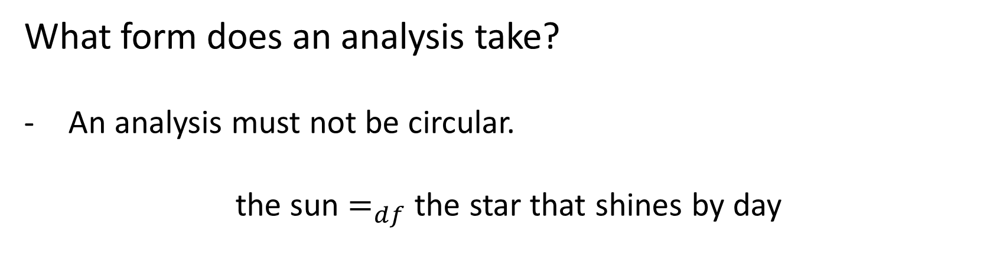
What form does an analysis take?
An analysis must not be circular.
the sun $=_{df}$ the star that shines by day

Slide 59
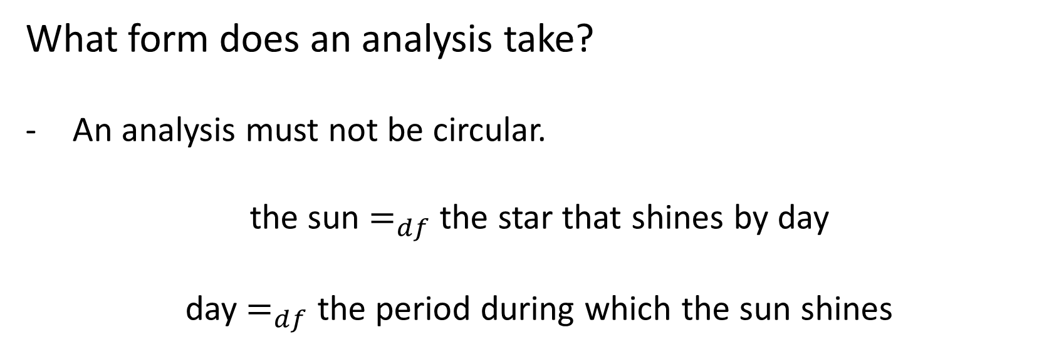
What form does an analysis take?
An analysis must not be circular.
the sun $=_{df}$ the star that shines by day
day $=_{df}$ the period during which the sun shines

Slide 60
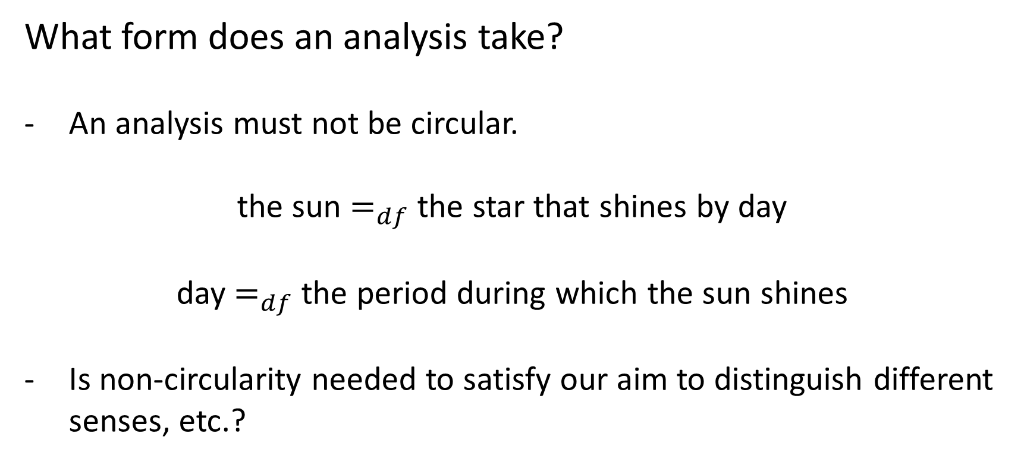
What form does an analysis take?
An analysis must not be circular.
the sun $=_{df}$ the star that shines by day
day $=_{df}$ the period during which the sun shines
Is non-circularity needed to satisfy our aim to distinguish different senses, etc.?

Slide 61
What form does an analysis take?
Classical definition: a condition that is necessary and sufficient for the application of the term (in all possible circumstances).

Slide 62
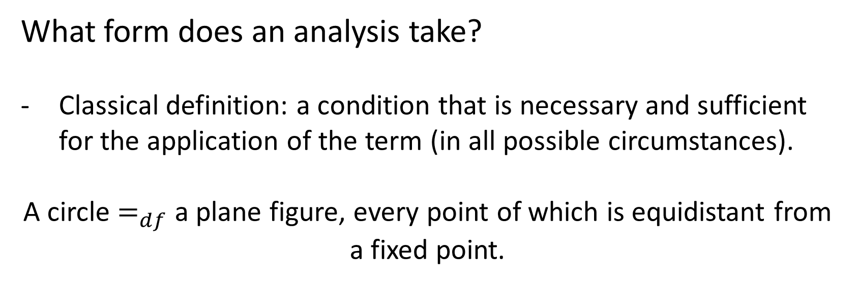
What form does an analysis take?
Classical definition: a condition that is necessary and sufficient for the application of the term (in all possible circumstances).
A circle $=_{df}$ a plane figure, every point of which is equidistant from a fixed point.

Slide 63
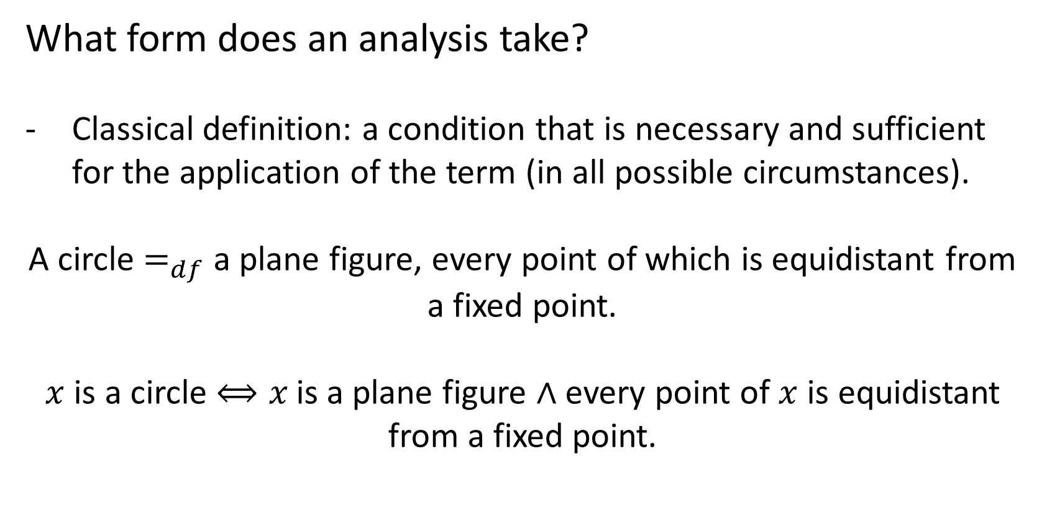
What form does an analysis take?
Classical definition: a condition that is necessary and sufficient for the application of the term (in all possible circumstances).
A circle $=_{df}$ a plane figure, every point of which is equidistant from a fixed point.
$x$ is a circle $⟺x$is a plane figure $∧$ every point of $x$ is equidistant from a fixed point.
Notes:
For this analysis to be true, the biconditional must hold.

Slide 64
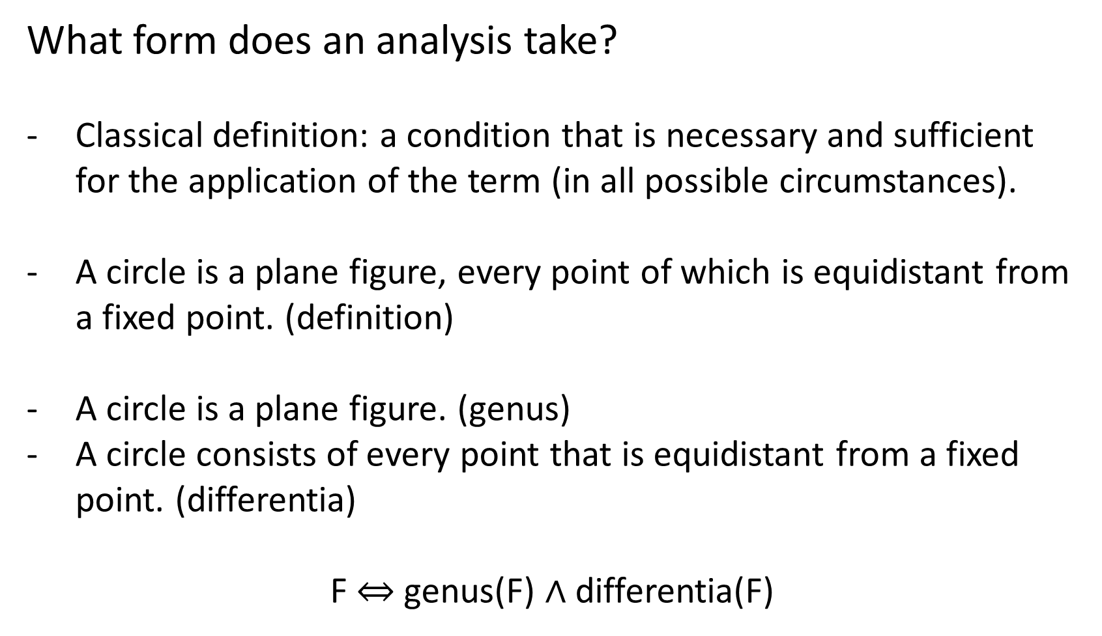
What form does an analysis take?
Classical definition: a condition that is necessary and sufficient for the application of the term (in all possible circumstances).
A circle is a plane figure, every point of which is equidistant from a fixed point. (definition)
A circle is a plane figure. (genus)
A circle consists of every point that is equidistant from a fixed point. (differentia)
F $⇔$ genus(F) $∧$ differentia(F)

Slide 65
Classical definition
A circle is a plane figure, every point of which is equidistant from a fixed point.
Other species of the genus plane figure: quadrilateral, conic section, etc. (What are their differentiae?)

Slide 66
Tree of Porphyry

Slide 67
Classical definition
The division of a genus into species (i) must be exhaustive, (ii) the constituent species must not overlap, (iii) must proceed on one principle.

Slide 68
Classical definition
The division of a genus into species (i) must be exhaustive, (ii) the constituent species must not overlap, (iii) must proceed on one principle.
So, for instance, dividing numbers into even and odd violates (i), while dividing them into even, odd and fractional violates (iii).

Slide 69
Classical definition
The division of a genus into species (i) must be exhaustive, (ii) the constituent species must not overlap, (iii) must proceed on one principle.
So, for instance, dividing numbers into even and odd violates (i), while dividing them into even, odd and fractional violates (iii).
These rules “express an ideal” rather than state a method.

Slide 70
Classical definition
We can’t be sure that a classification is exhaustive; more species could always appear, possibly requiring us to revise the differentiae of existing species.
Nor can we be sure that a pair of species is exclusive; what if we encounter a specimen that shares the characteristics of both?
For instance, an amphibian specimen would spoil a division of animals into those of the air, land, and sea. (Cohen & Nagel, p.242)

Slide 71
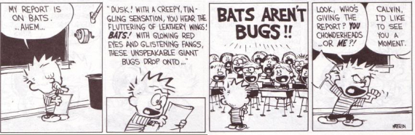
Classical definition
Such discoveries force us back to the drawing board, in search of new differentiae to form the basis of a division.
For instance, we now classify animals based on number of middle ear bones, rather than their surface similarity or where they live.

Slide 72
Classical definition (open texture)
The classical form of analysis is threatened even without new discoveries. All it takes is hypothetical cases.
Friedrich Waismann considers the case of ‘gold’, which “seems to be defined with absolute precision, say by the spectrum of gold with its characteristic lines.”
But asks us to imagine a substance that satisfied the definition, yet emitted a new sort of radiation.

Slide 73
Classical definition (open texture)
On the classical theory, this substance must be gold too, but our intuition about the case doesn’t necessarily match this prediction.
Rather than automatically including it in the category ‘gold’, Waismann thinks, we would be unsure how to proceed.
This proves that our original definition of ‘gold’ was too strong; it treats an unclear case as a straightforward one of inclusion.
We could add a clause to the definition discussing radiation, but this misses the broader point.

Slide 74
Classical definition (open texture)
We can always come up with more hypothetical cases to conflict with the next iteration of the definition.
No matter how hard we try, we cannot anticipate every feature of a case that could cause us to doubt its application, and bake it in to our definition.
Waismann calls this feature of empirical concepts their “open texture.”

Slide 75
Classical definition (open texture)
Instead of definitions classically understood as necessary and sufficient conditions, our words have what we might call working definitions, which distinguish the target category from known alternatives – e.g. gold from other known metals, such as steel – but leave open what to say about all sorts of hypothetical cases, such as Waismann’s radiation case.

Slide 76
Classical definition (open texture)
The largest asteroid Ceres is not nearly massive enough to have accumulated all of the other asteroids, nor is it massive enough to shove the asteroids out of the solar system. It is not a dominant mass within the asteroid belt. The exact same could be said of Pluto and 2003 UB313 (which are essentially the same size and both in the Kuiper belt along with millions of other bodies). Every one of the eight planets easily passes this test though. The eight planets were created from an accumulation of most of the material that remained in their vicinity. They are the dominant bodies in their regions of space. (...) The important point to remember, however, is that the difference between the eight planets and everything else known in the solar system is so huge that even a definition with a lot of wiggle room will not make any difference. (...) The precise definition in the IAU resolution may be a tad unclear, but the concept is absolutely rock solid with absolutely no room for doubt about which objects do and do not belong. (Brown 2006; cited in Egré 2012)

Slide 77
Classical definition (open texture)
Rather than try to construct a detailed definition of a planet which is designed to cover all future possibilities, the WGESP has agreed to restrict itself to developing a working definition applicable to the cases where there already are claimed detections … As new claims are made in the future, the WGESP will weigh their individual merits and circumstances, and will try to fit the new objects into the WGESP definition of a “planet,” revising this definition as necessary. This is a gradualist approach with an evolving definition, guided by the observations that will decide all in the end. (IAU Working Group on Extrasolar Planets, 2003; quoted in Ludlow 2011, p.77)

Slide 78
Classical definition (open texture)
But what is a “working definition”?
It is not a classical definition, a criterion both necessary and sufficient; as we have seen, that is a stronger commitment than what those drafting it intend.
We could consider it merely a sufficient condition, leaving open other ways of qualifying as a planet.
But even that seems too strong; the authors have reserved the right to exclude future cases that satisfy its clauses (the way we might reserve the right to exclude a substance that emitted a new sort of radiation from the category gold).

Slide 79
Classical definition (open texture)
Waismann suggests that the application of a predicate F might strengthen or weaken the application of another G, without either ensuring it, or ruling it out entirely.
There are a number of ways this idea could be developed.
In this course, we will introduce a framework that can precisely code lexical meanings in a manner that is nonmonotonic.
This way, analyses may be specified that appropriately divide the cases seen so far, and are updated as new cases are weighed on their “individual merits and circumstances.”
Our model for this process is the way a precedent of cases influences decisions in the common law.

Slide 80
Bibliography
Aristotle. The Categories.
Brown, M. 2006. The Eight Planets. http://web.gps.caltech.edu/mbrown/eightplanets/
Brown, M. 2010. How I Killed Pluto and Why It Had It Coming. Spiegel and Grau.
Cohen, M and E. Nagel. 1968. An Introduction to Logic and Scientific Method.
Egré, P. 2012. What is a Planet? In Festschrift for Veltman, Groenendijk and Stokhof.
Elbourne, P. 2011. Meaning: A Slim Guide to Semantics. Oxford: OUP.
Hare, R. 1952. The Language of Morals. Oxford: OUP.
Krifka, M. 2012. Definitional Generics. In Alda Mari, Claire Beyssade and Fabio Del Prete (eds.) Genericity. Oxford: OUP, 372-389.
Ludlow, P. 2011. Living Words. Oxford: OUP.
Waismann, F. 1945. Verifiability. Proceedings of the Aristotelian Society, Supplementary Volume XIX.

